Slide 1
Google Scholar
http://scholar.google.com/

Slide 2
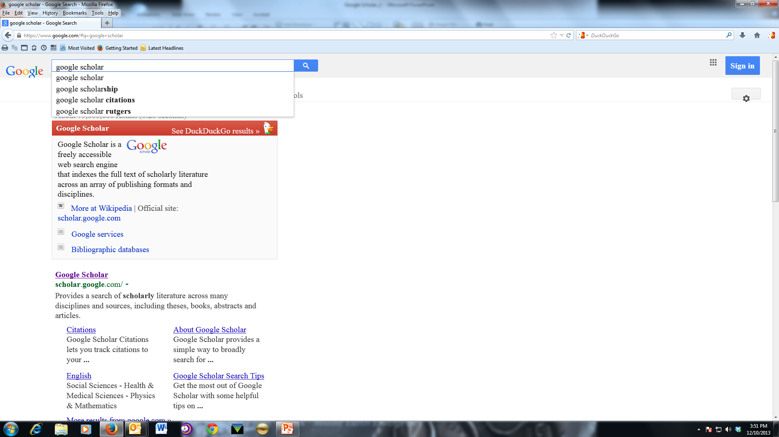
Notes:
How to find: google it or url is scholar.google.com

Slide 3
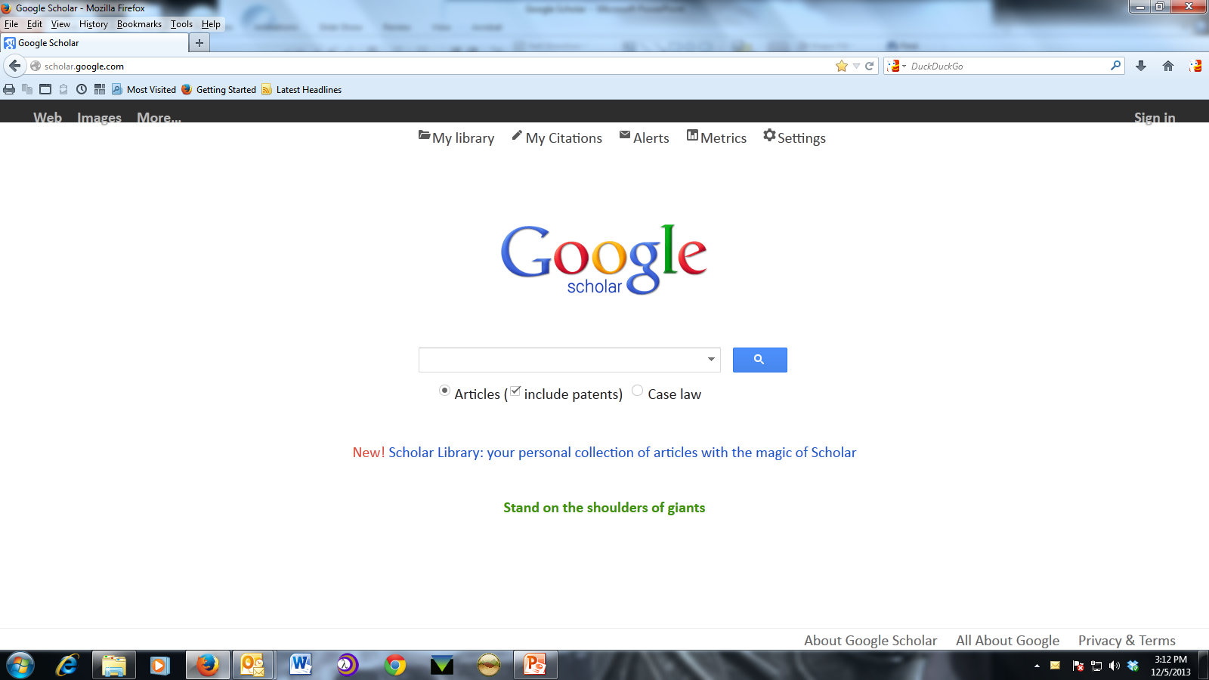
Notes:
Starting with Settings since this will take us to library links. You may also want to set up your preferred default settings.

Slide 4
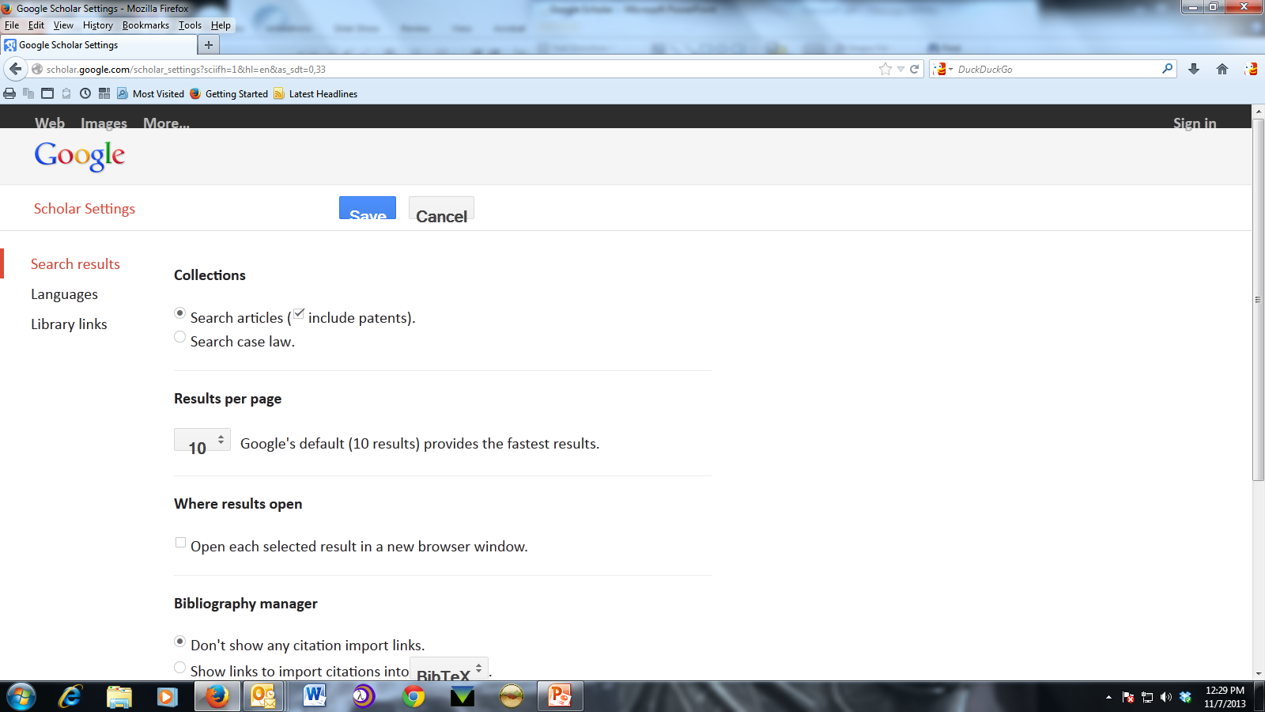
Notes:
Settings you can change. May want to select option to open each selected result in a new browser window. On to Library Links

Slide 5
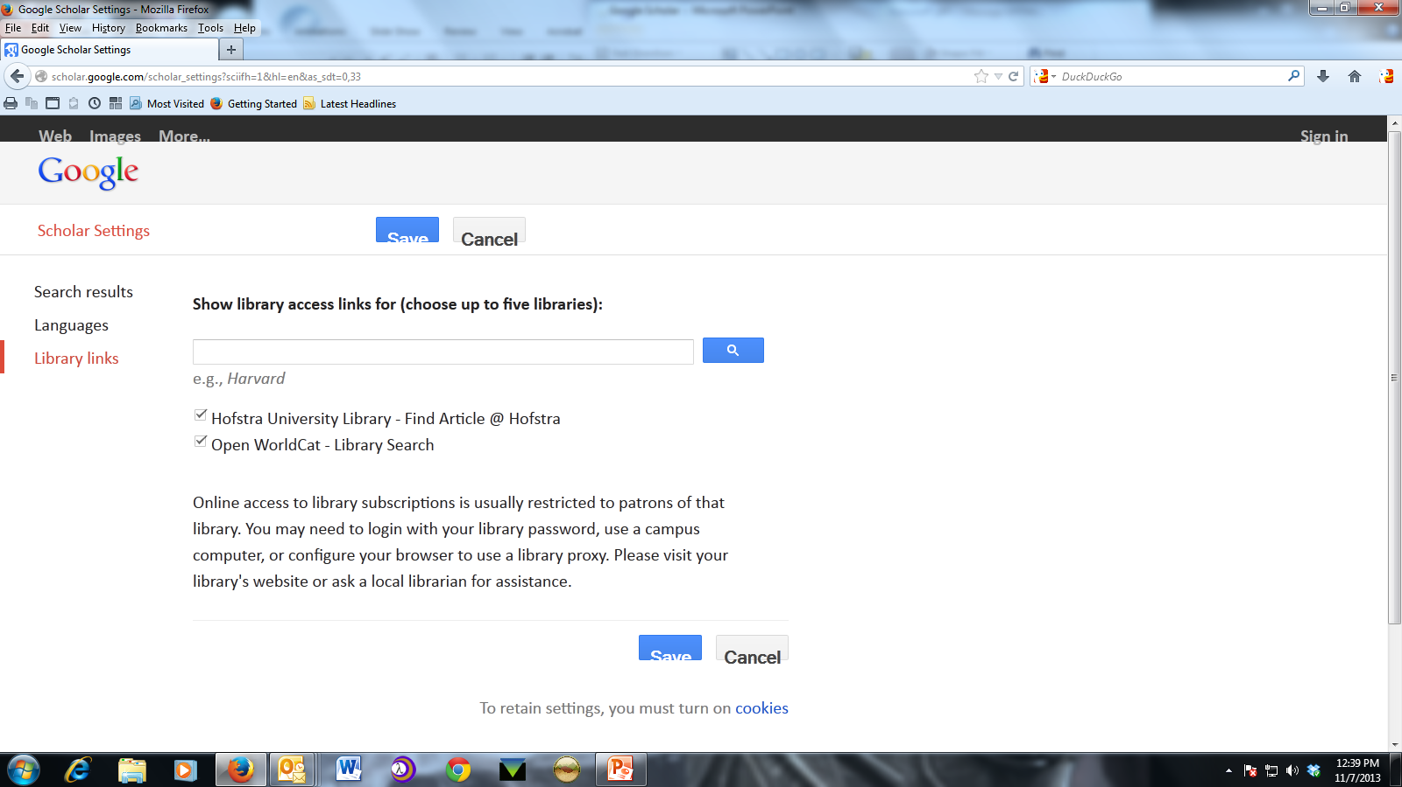
Notes:
Library links are important. While on campus google identifies the IP address as Hofstra and automatically shows you if the article is available through a university database. This includes Axinn Library’s resources. By adding Hofstra University Library to the Library Links you can learn if Hofstra has the item when off campus. Clicking on the article link will take you to the Portal login and access the article after logging in. I will bring this up again later when we look at search results.

Slide 6
Notes:
Back to front page of Google Scholar and we will now look at the “About Google Scholar”.

Slide 7
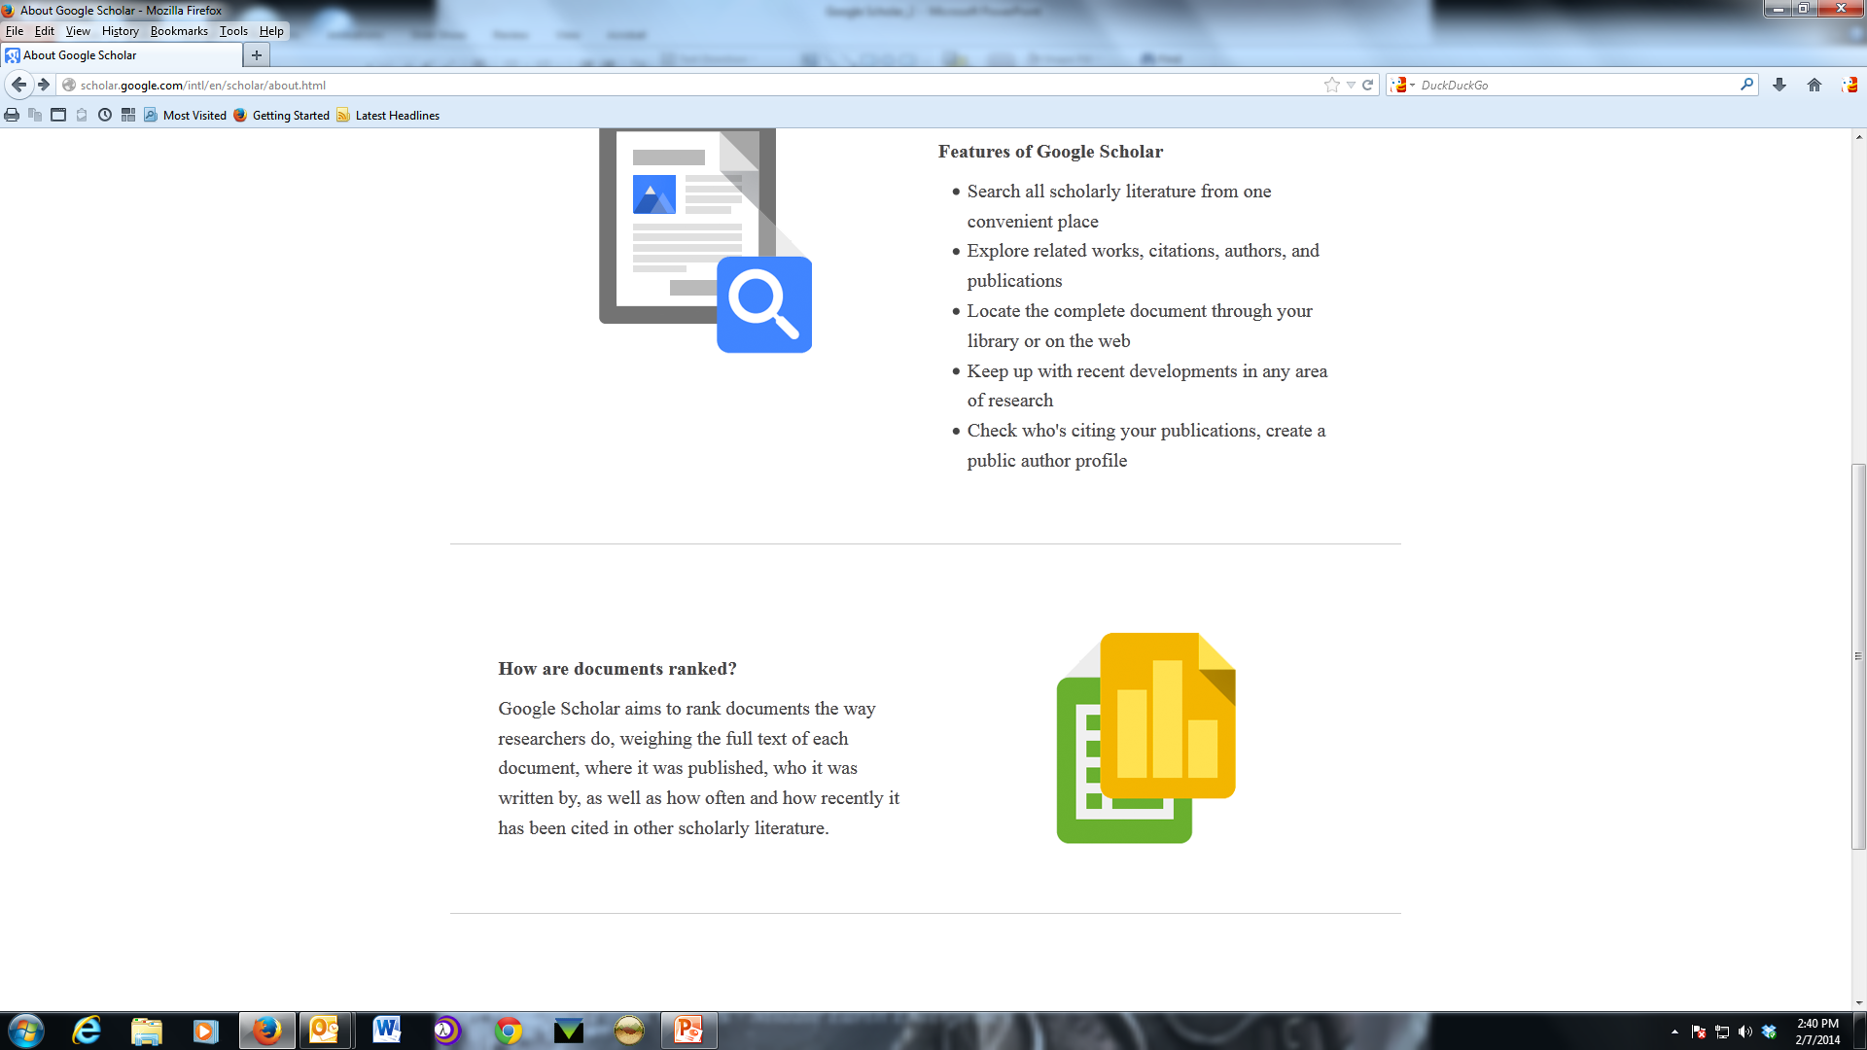
Notes:
Your search will be limited to “scholarly literature”. This means that the resources that Google Scholar uses are selected for quality of information, but there are downsides that I will talk about as we go along.

Slide 8
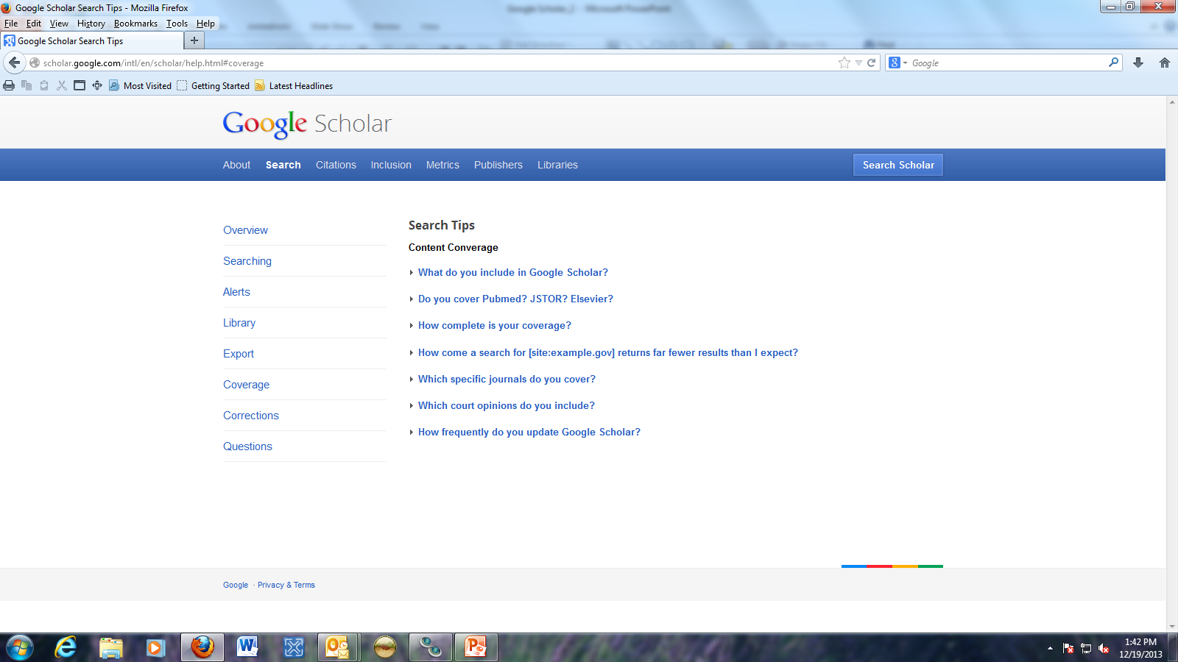
http://heinonline.blogspot.com/2009/11/heinonline-or-google-scholar-why-you.html The post on what Google Scholar does not include in their bots crawl thru Hein.

Slide 9
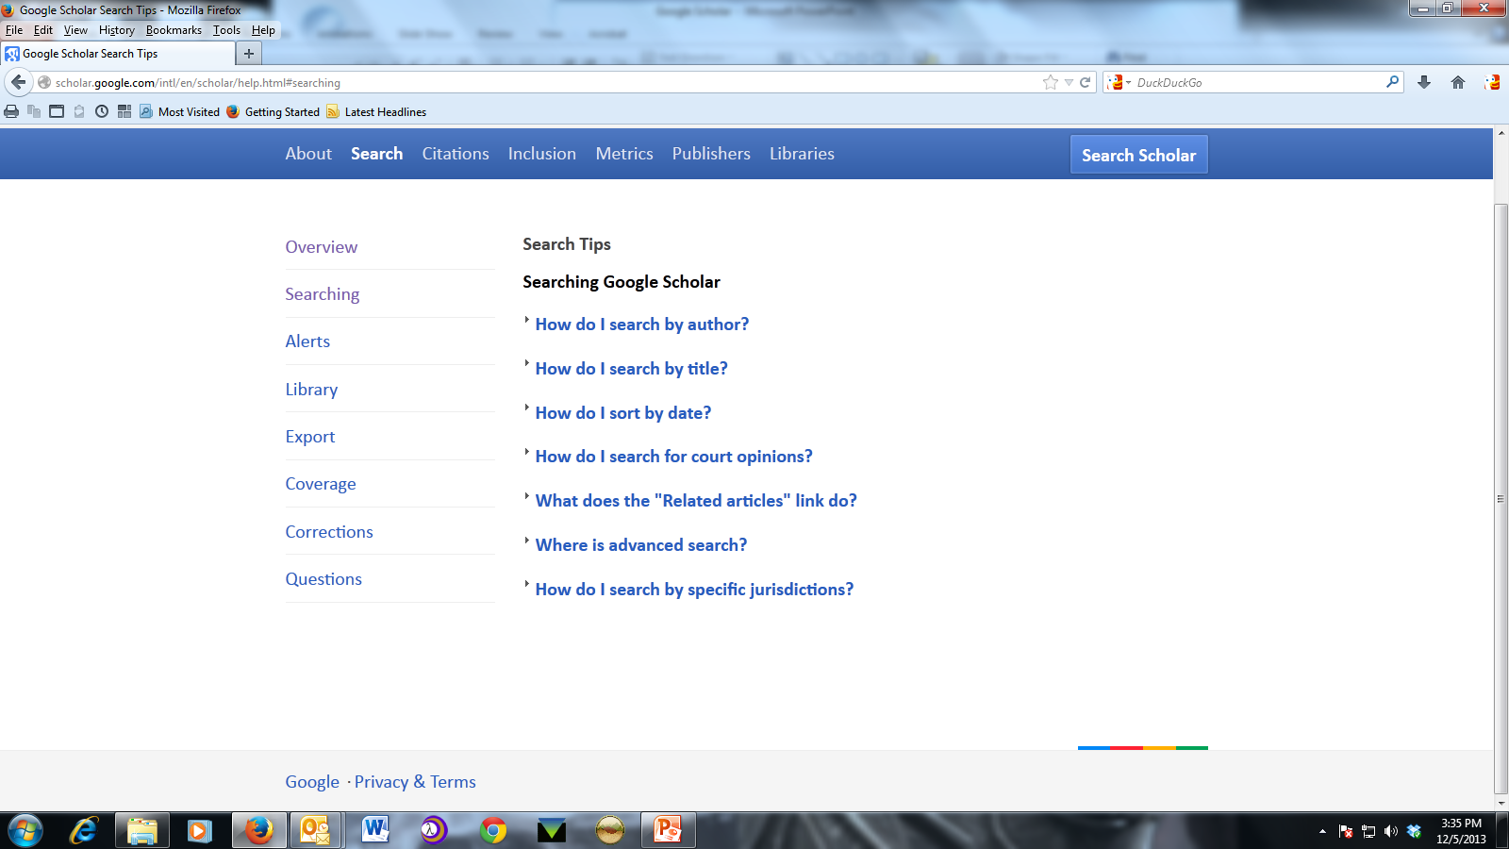
Notes:
How to search specific fields such as author and what some of the functions are. We will review many of these.

Slide 10
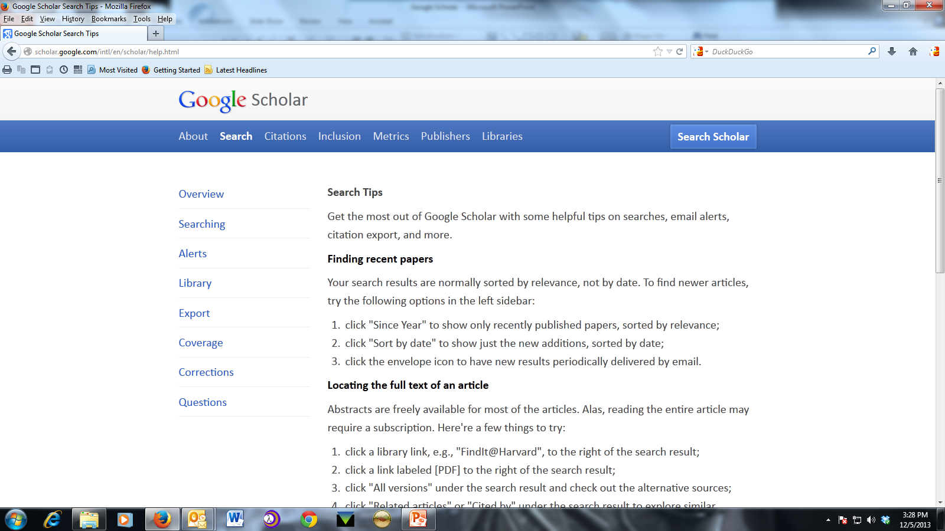
Notes:
These are filter and sort options, how to find similar articles and how to use the library link to locate the full-text of the article.

Slide 11
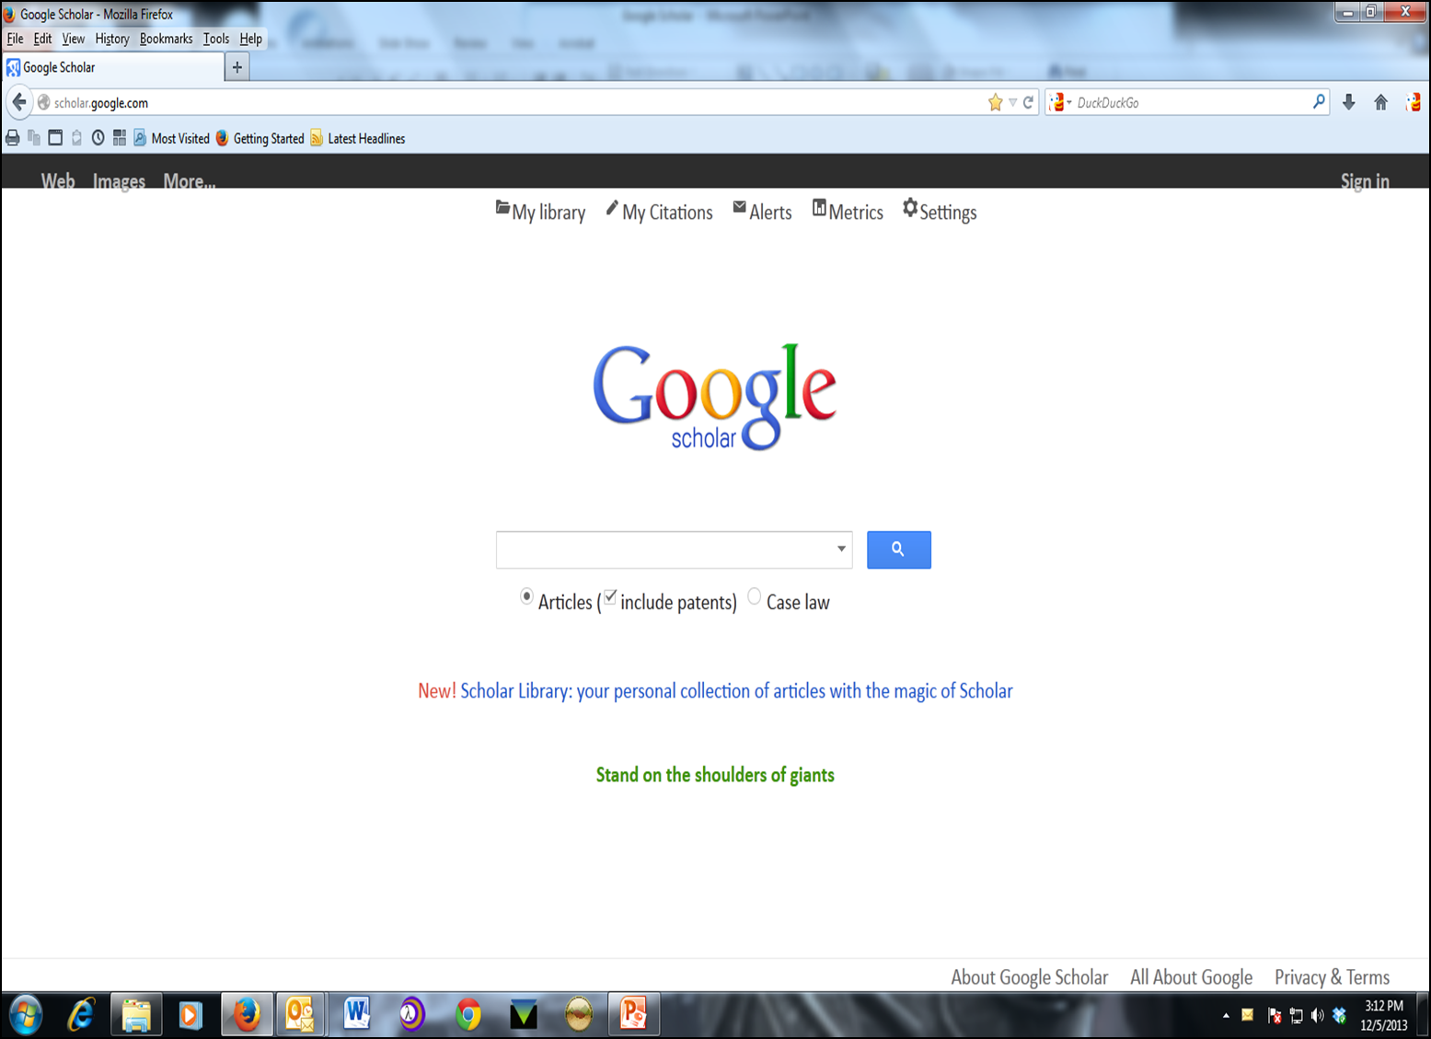
Notes:
I want to point out the drop menu to the right of the search box and that the search is for Articles including patents. We could uncheck the patents if not needed.

Slide 12
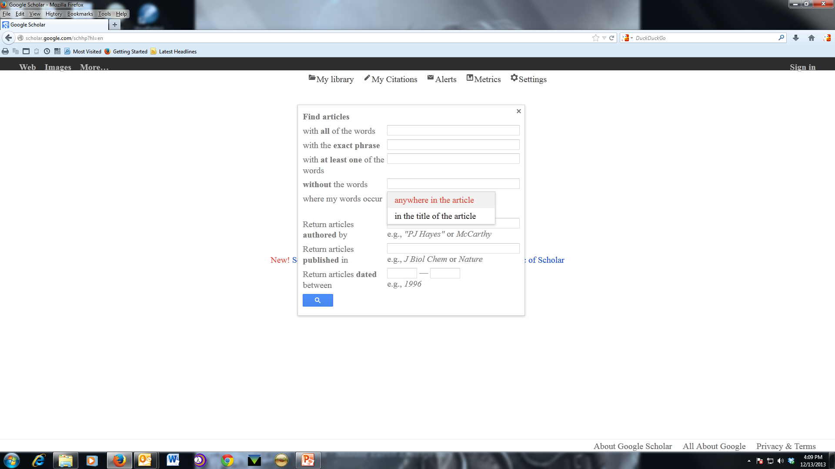
Notes:
By clicking on the menu we are taken to the Google Scholar Advanced Search template. Note the various options for a relatively specific search: author, words in title, journal name, etc. I find this useful for verifying law journal citations when I suspect that the volume or page number(s) are incorrect. Now to talk about one of the downsides of Google Scholar. Although it crawls Hein Online’s Law Journal Library only about half of Hein’s content will show in Google Scholar. Generally Notes and Comments are not returned in Google Scholar’s result list. Follow the Hein Online blog post link to learn more. This post informs us that the most cited article in a law journal/review is a Comment. You will not find this Comment through Google Scholar although it is found with a regular Google search.

Slide 13
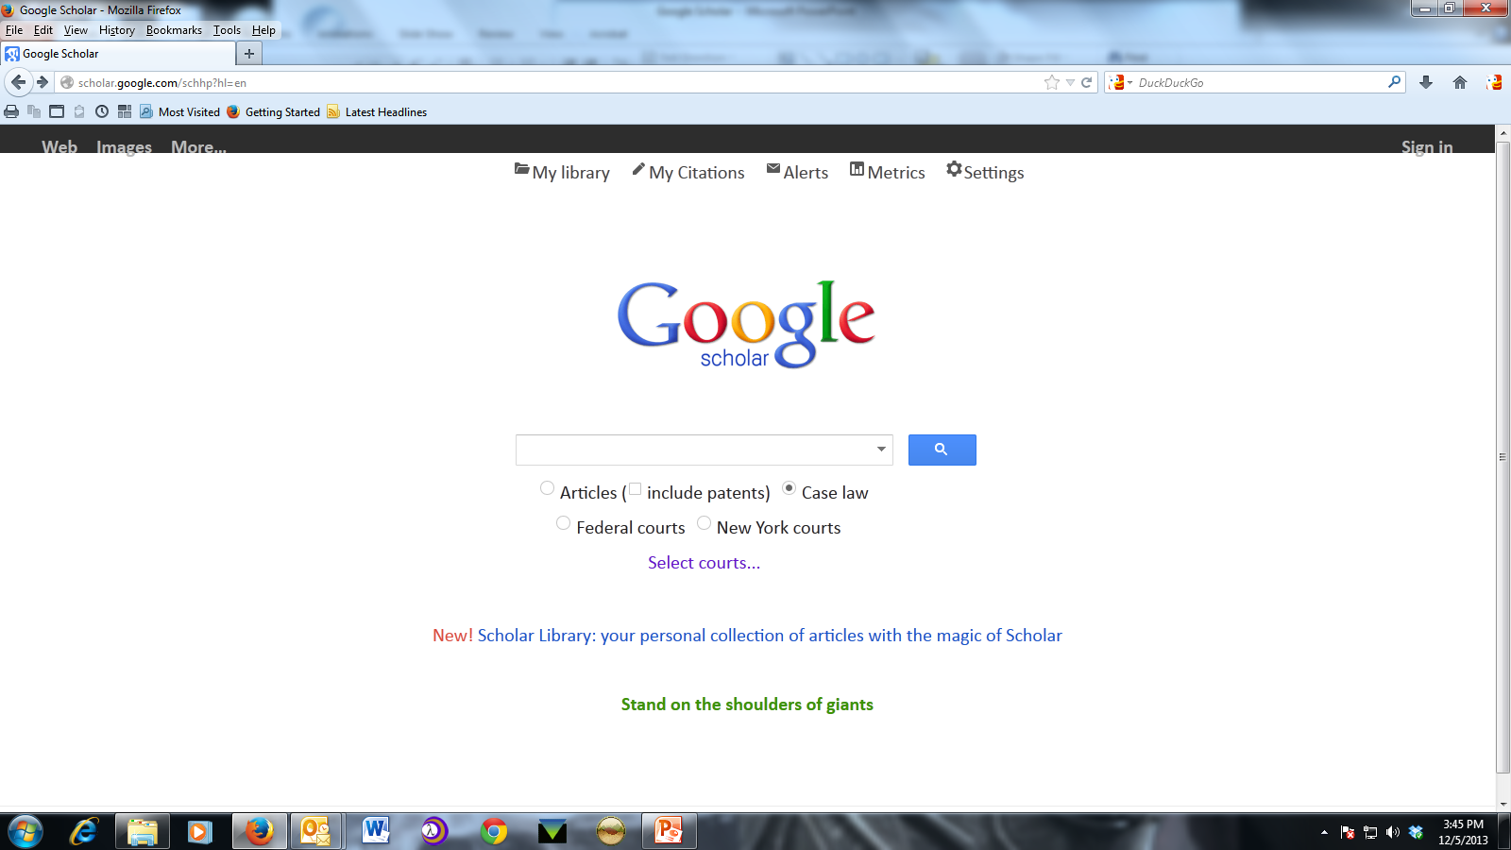
Notes:
Back to the main screen and when we select for “Case Law” the option to select a jurisdiction or other courts appears.

Slide 14
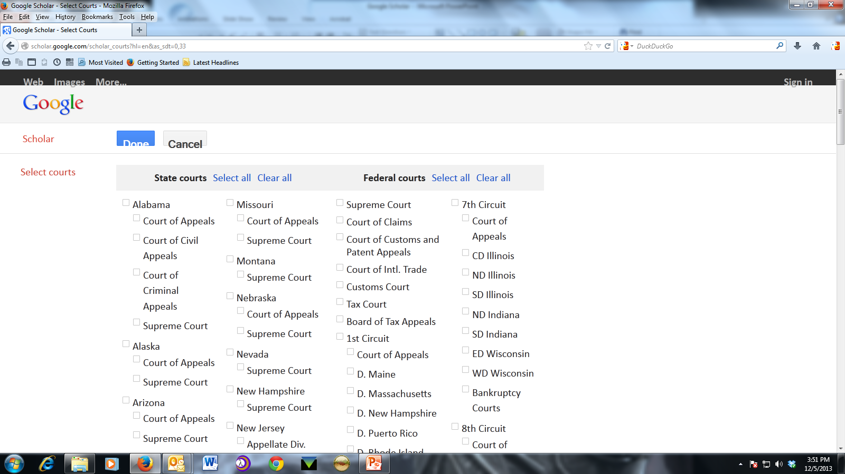
Notes:
So as you can see, we can be very specific about which courts we want to search.

Slide 15
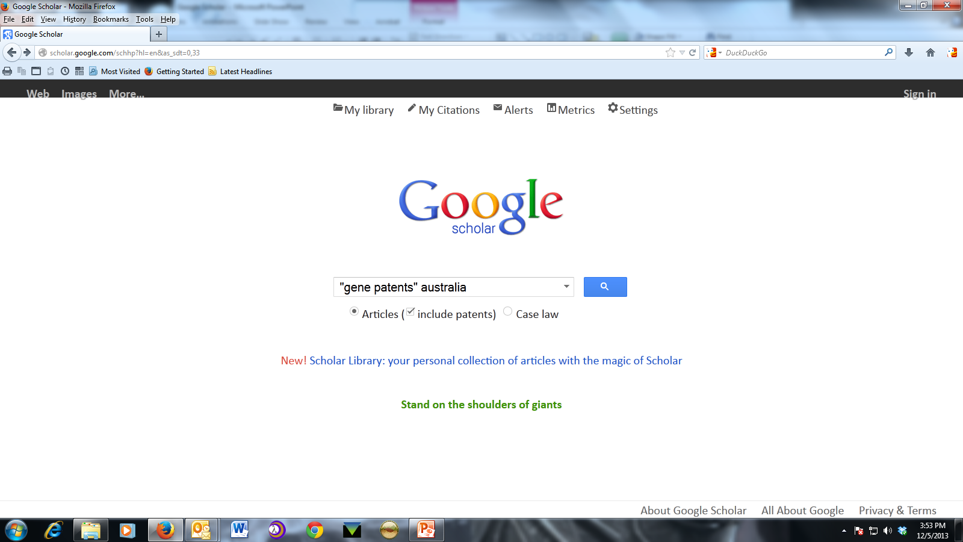
Notes:
I had a request recently wherein gene patents in different jurisdictions was part of the research issue. I thought this a good search to show some of the features and am using it with the permission of the requester. This is a basic search but is a useful illustration. Note, I am starting with articles & patents.

Slide 16
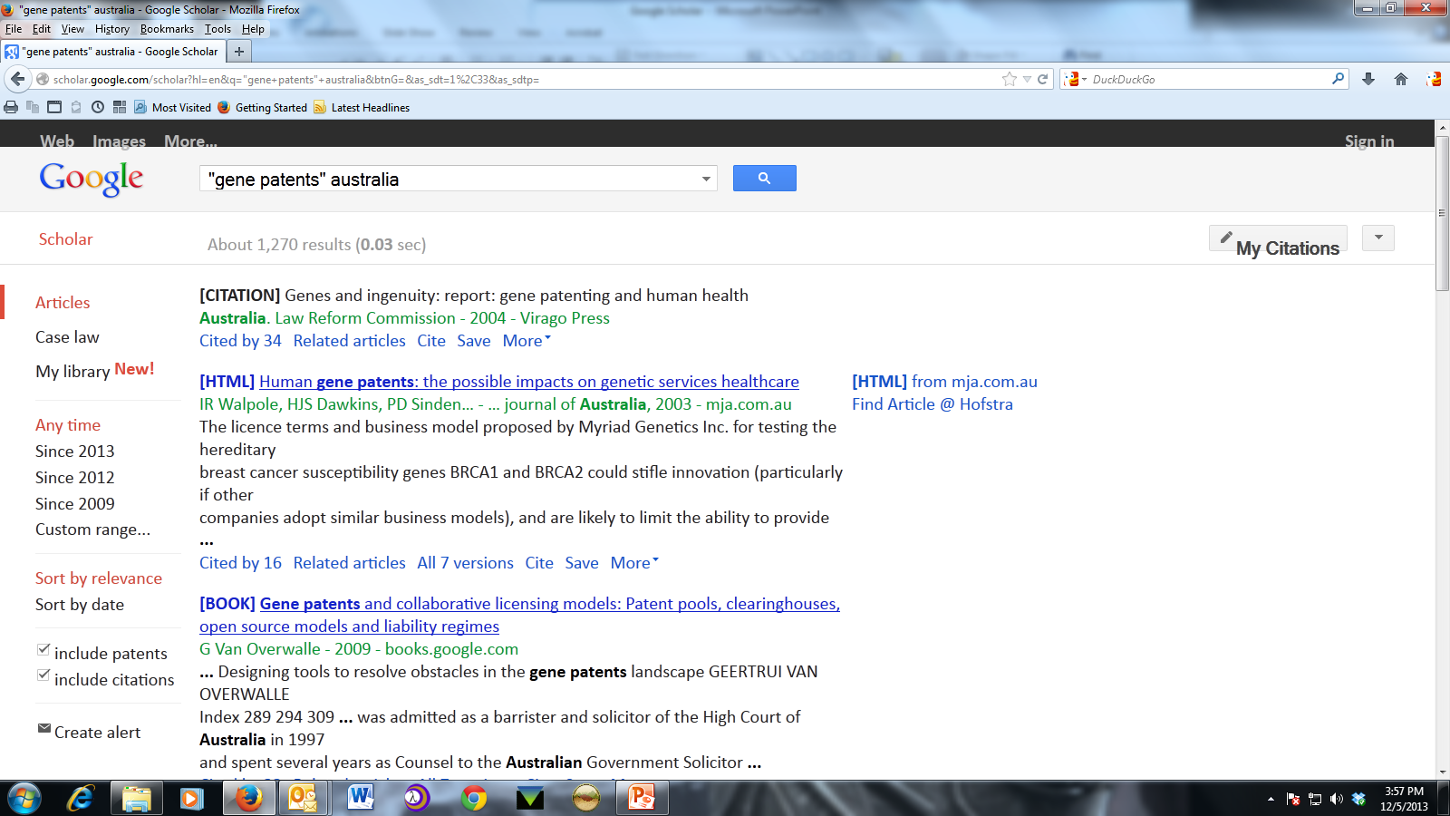
Will show automatically when on campus, but must set Library Links – earlier slide - to see when off campus.
Notes:
On the left are simple sort – relevance/date - and filter options-date range. Remember the “Library Links”? On the right, you can see that the second article can be obtained through Hofstra. Under each citation/link you see the Cited By; Related articles; cite; save; & more. We will look at some but not all of these.

Slide 17
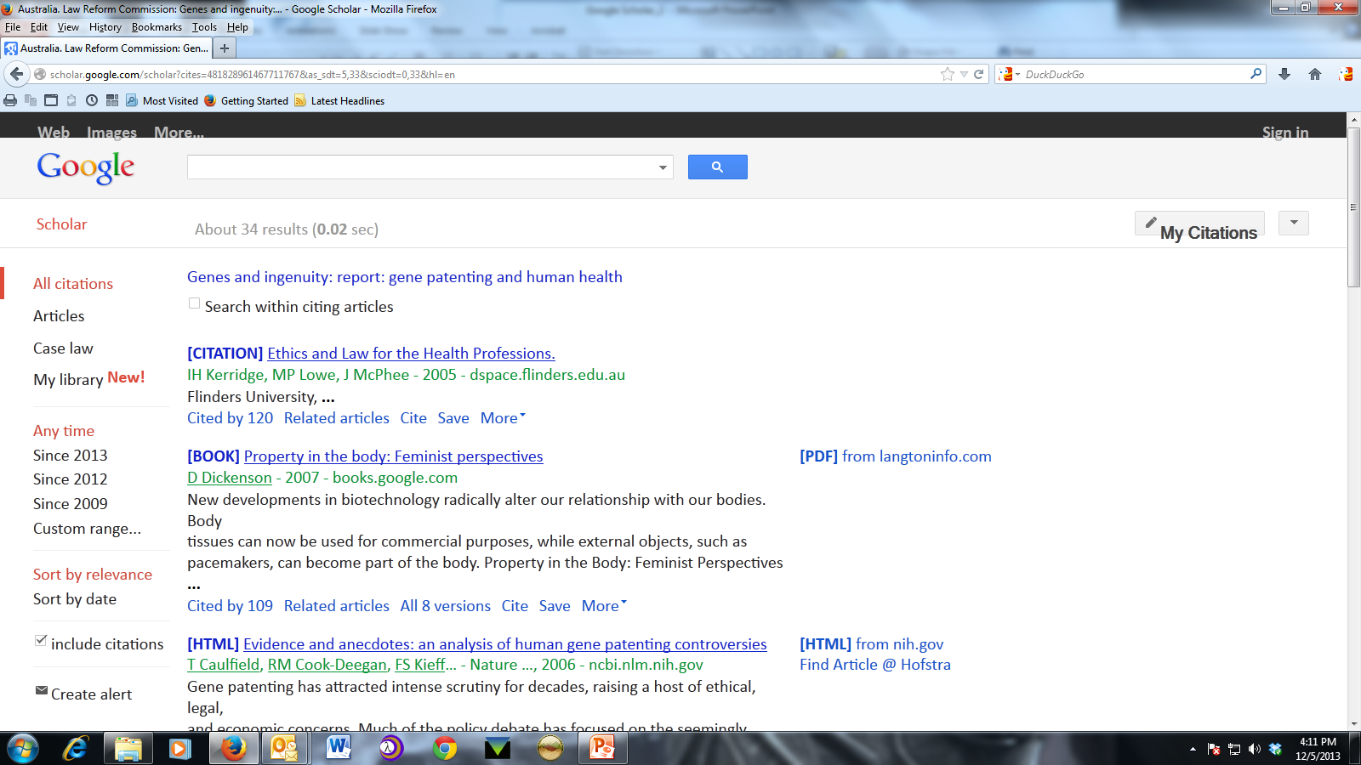
Cited By Feature
Notes:
This is the Cited By and you have the option of search within these results. It can be easy to get lost while going through search results which is one reason you may want to check the “Open in new window” in the Settings page.

Slide 18
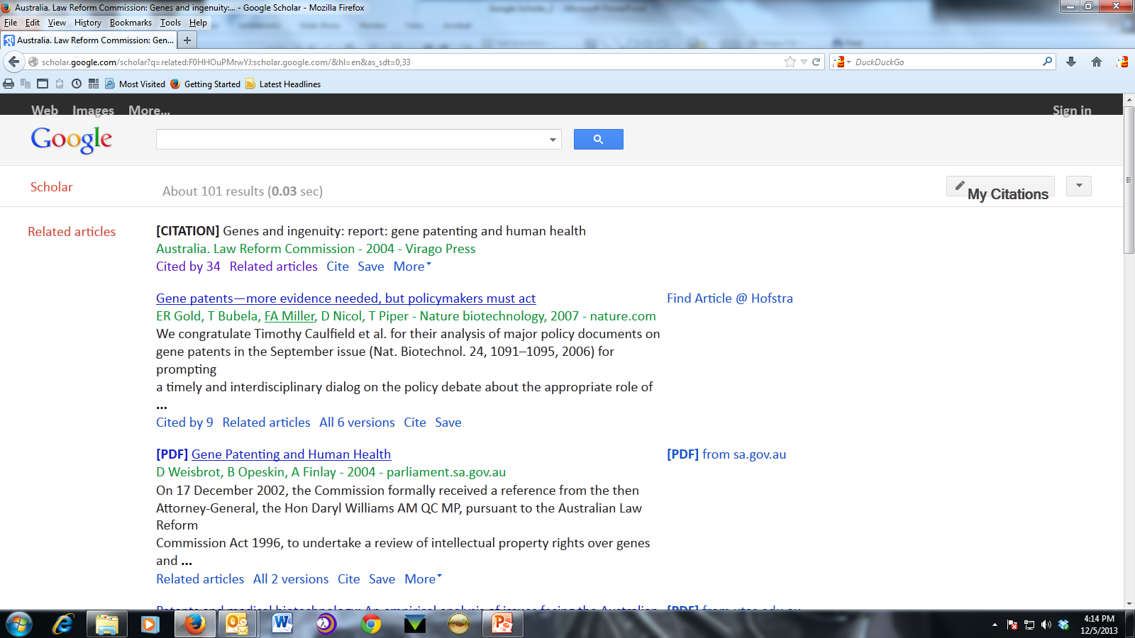
Related Articles Feature
Notes:
Related articles “find documents similar to the given search results”. This is Google Scholar language and does not tell us much. But as you can see is worth viewing.

Slide 19
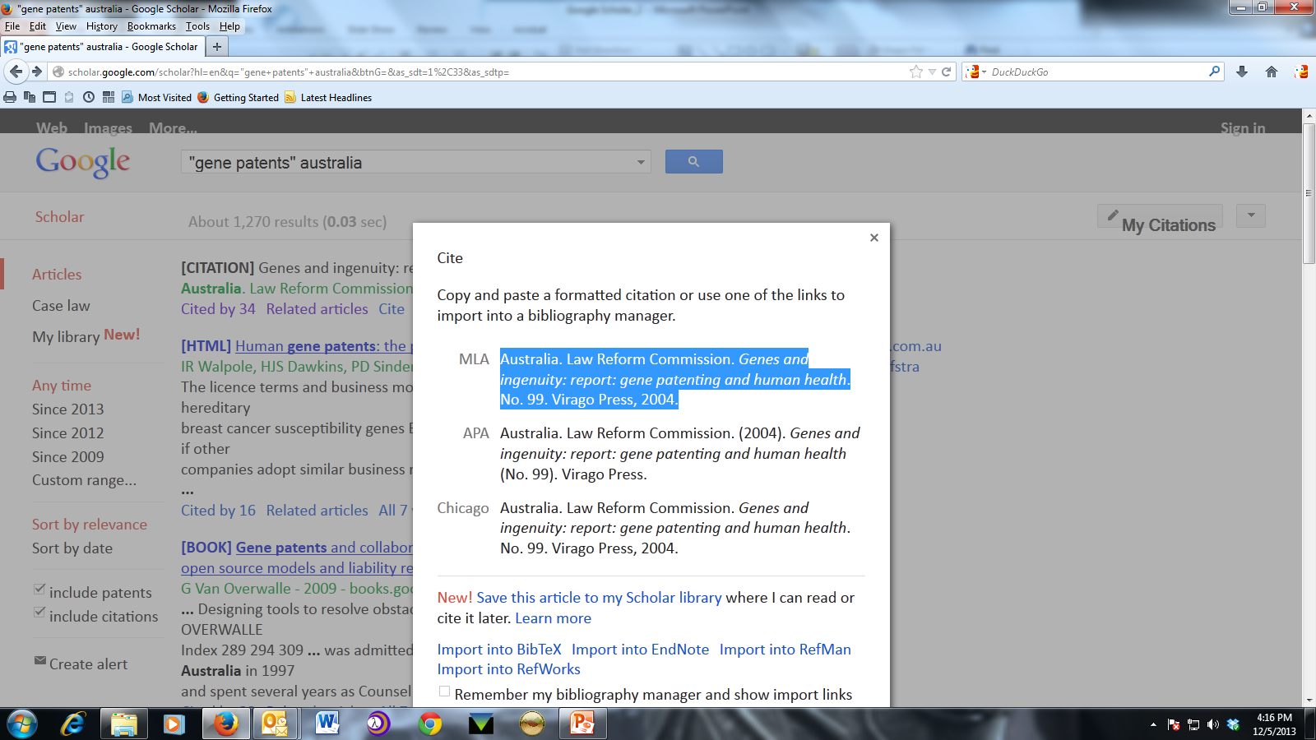
A proper citation is important if you must submit an ILL request.
Notes:
Sometimes it is necessary to place and interlibrary loan request to obtain a document. It is important to have correct information because if you do not the request will be cancelled for incomplete information. I will now click on the “Case Law” link….

Slide 20
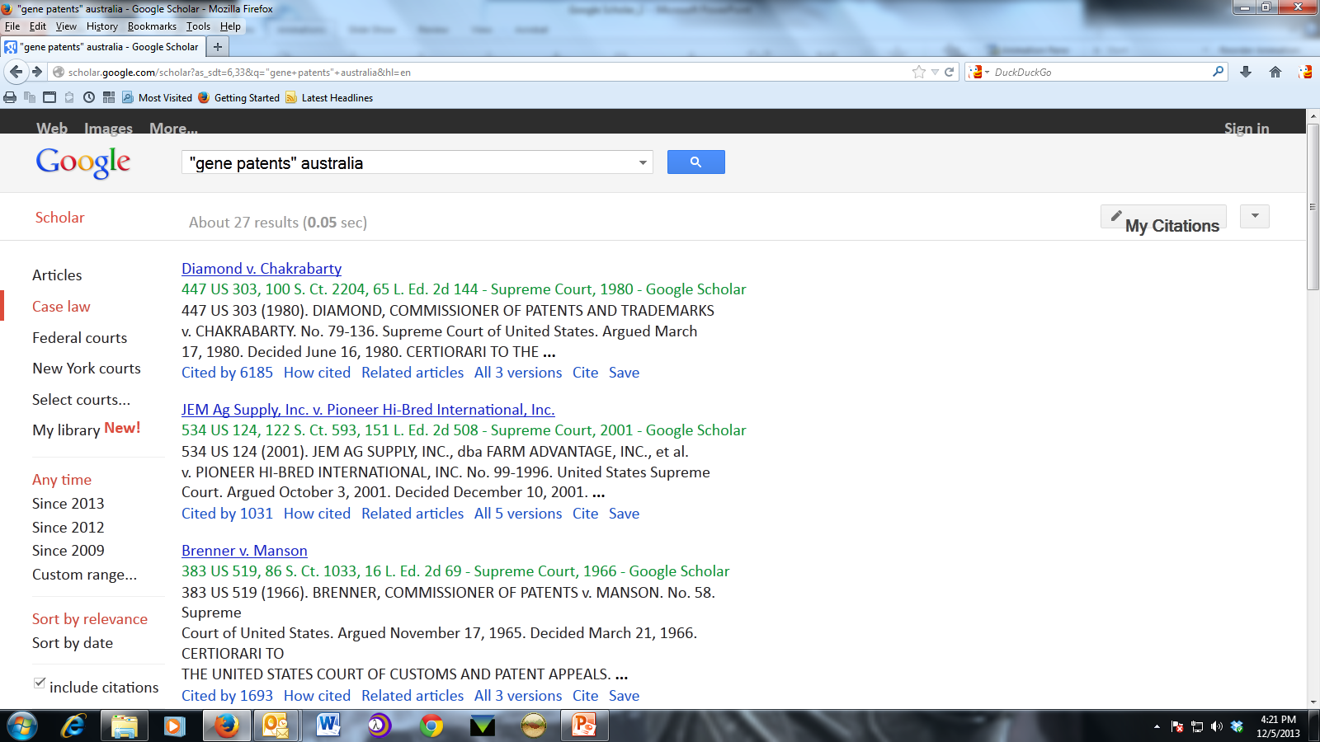
Notice results are U.S. case law only. You can find scholarly literature from other countries but not case law.
Notes:
And it automatically runs the search in United States case law. Currently, Google Scholar allows you to search and read published opinions of US state appellate and supreme court cases since 1950, US federal district, appellate, tax and bankruptcy courts since 1923 and US Supreme Court cases since 1791. Be careful with the dates of coverage. Important state decisions – Palsgraf – are not included. Another problem is that we do not know how frequently the case law database is updated. Google Scholar is OK to start your case law research but you really must use a commercial service to update your case.

Slide 21
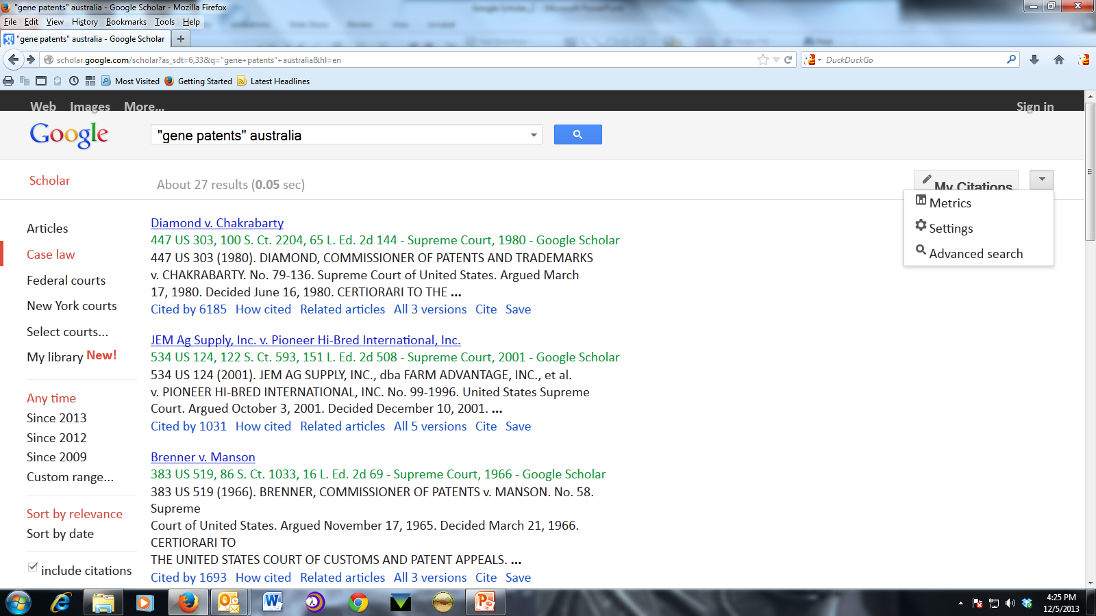

Slide 22
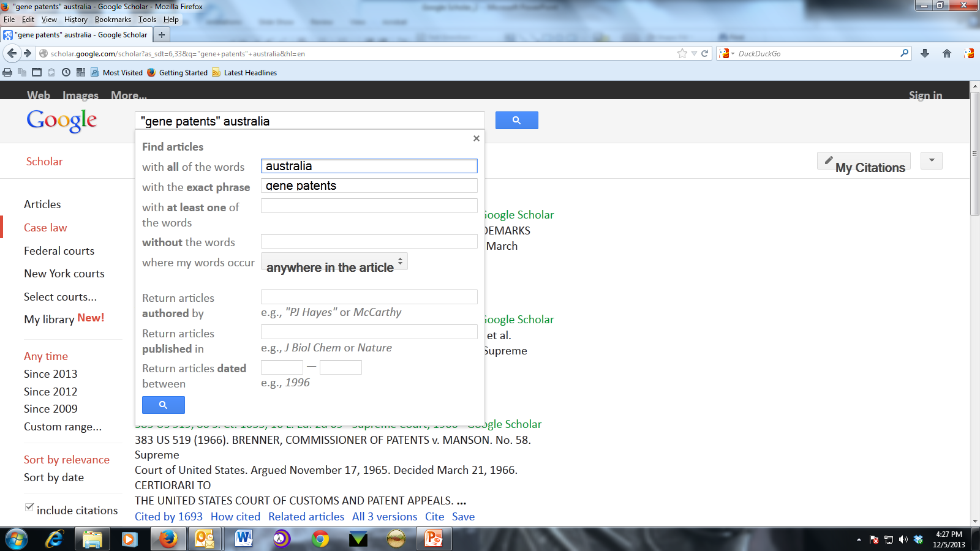
Returns us to the original query in the Advanced Search box.

Slide 23
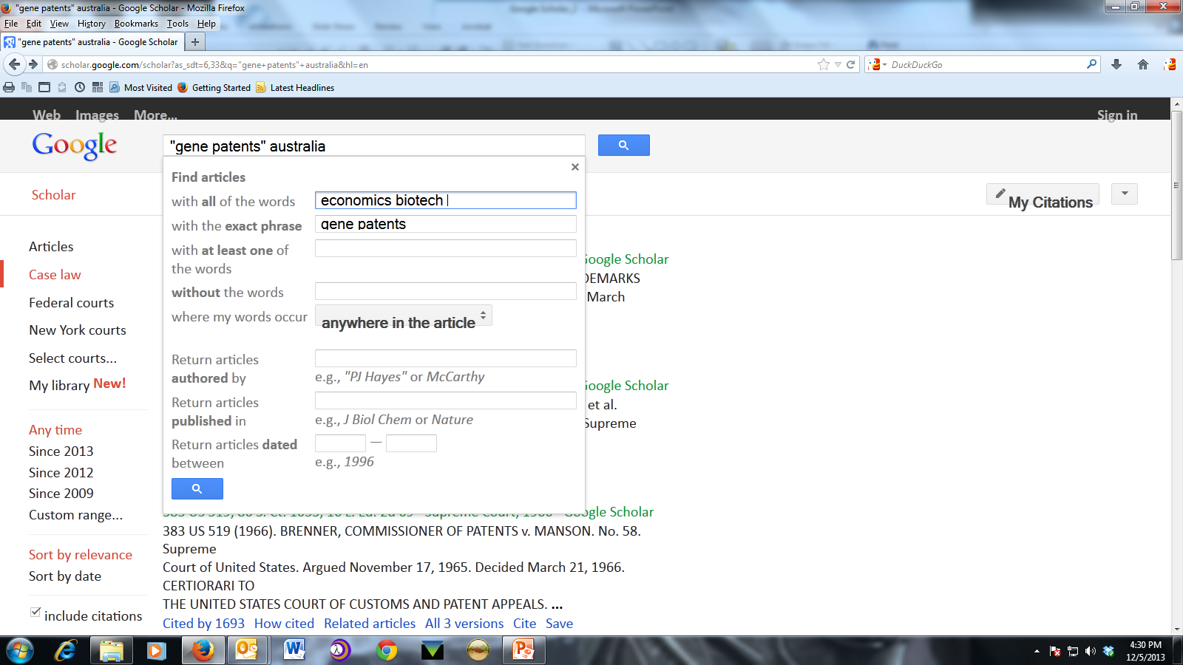
So we can modify the original search query.

Slide 24
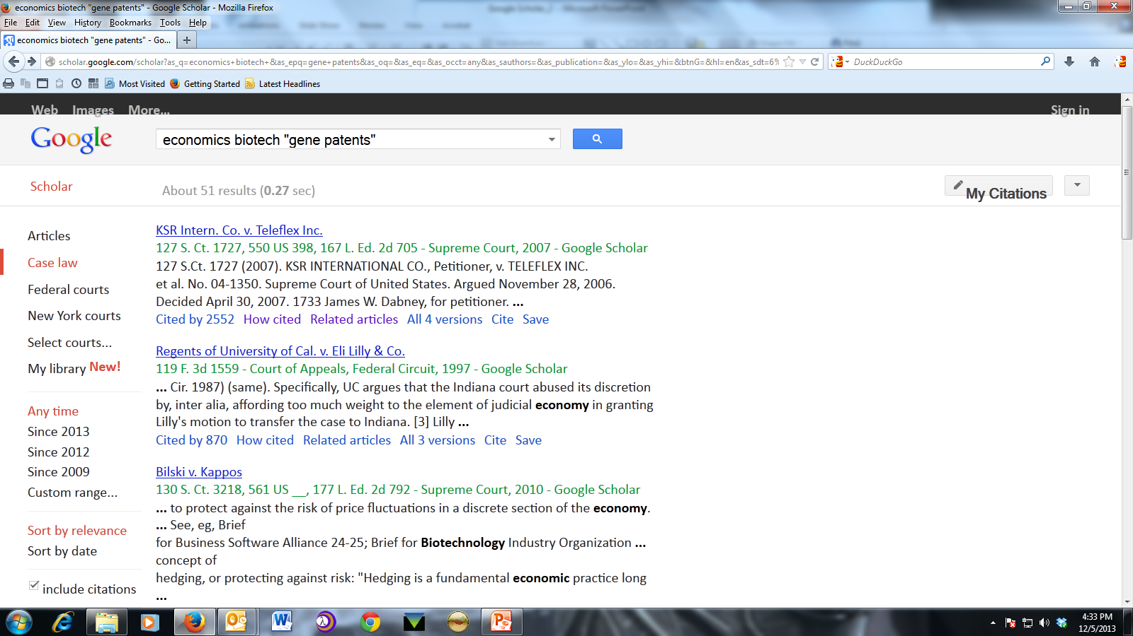
Result list in U.S. case law
Notes:
We will come back to Cited by but let’s start with “How Cited”. Note the “Related Articles” and Cite features that serve the same purpose in case law results as in articles results. I will not show these.

Slide 25
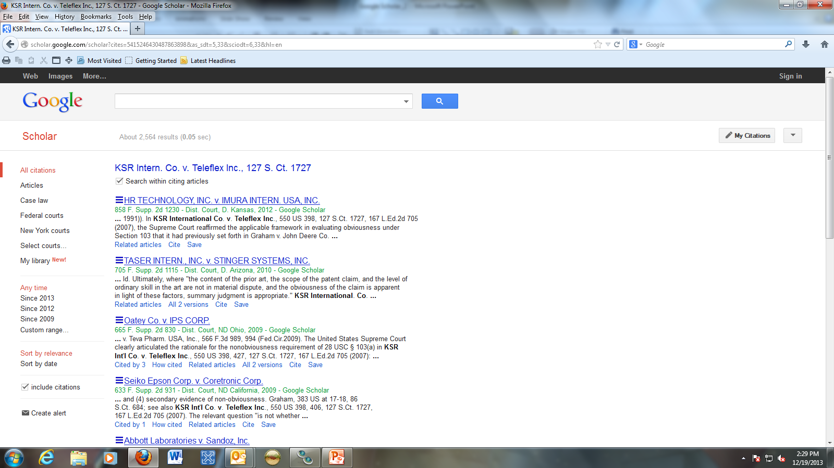
Cited By Results
Cited by is not a substitute for updating with Bloomberg/Lexis/Westlaw. Google does not update the case law database on a regular basis.
Notes:
Again the search within citing articles option and considering the number of results for this case a very useful feature. The commercial services with the info button will tell you how frequently a specific database is updated. We have no idea with Google.

Slide 26
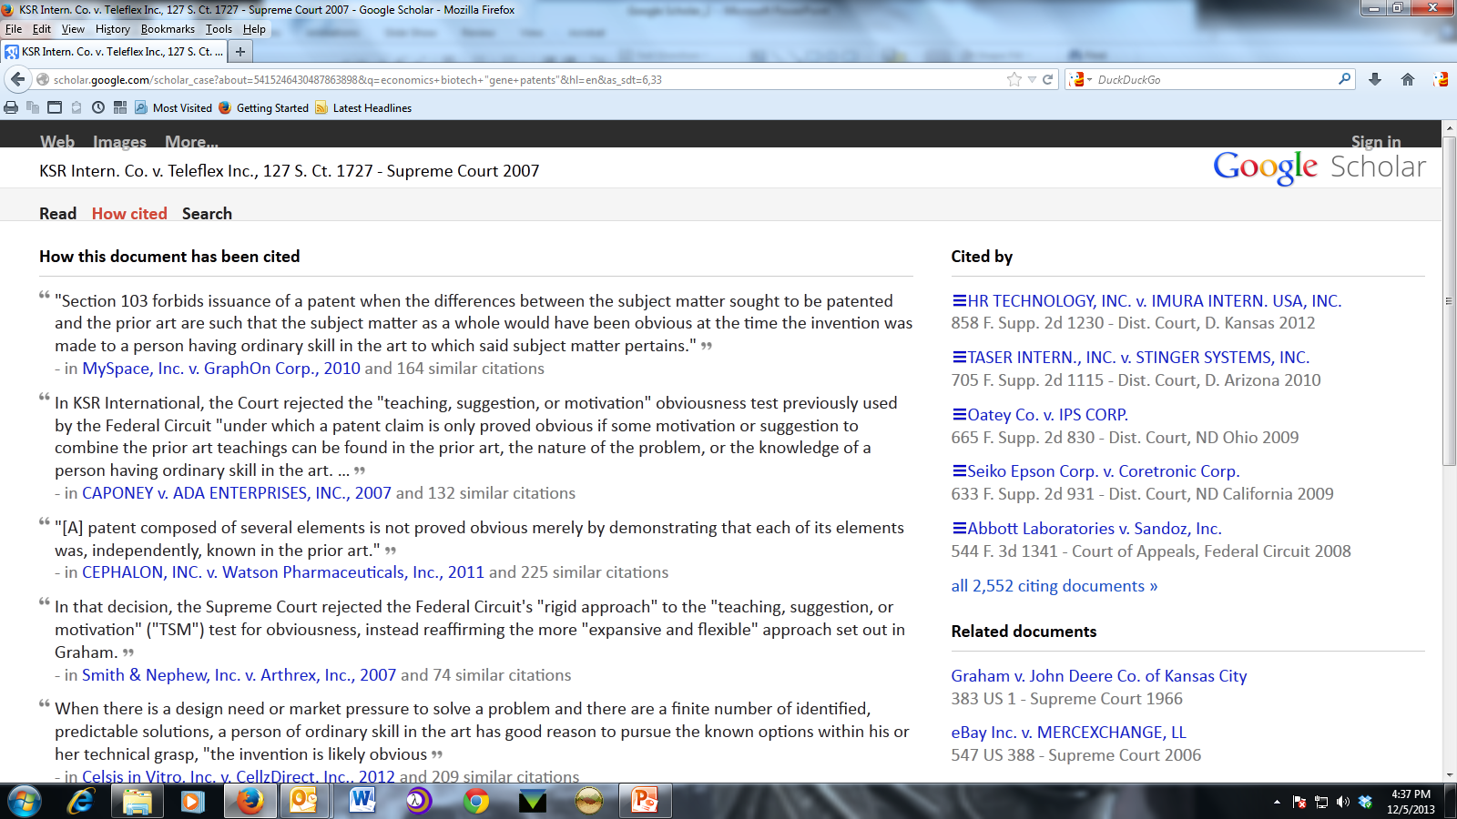
How Cited Results
Does not indicate if is still good law or have the analytic features of the commercial services.
Notes:
Not really headnotes but at least some means of discovering context for the cited case. Does not have the full analytic functionality of any of the commercial services.

Slide 27
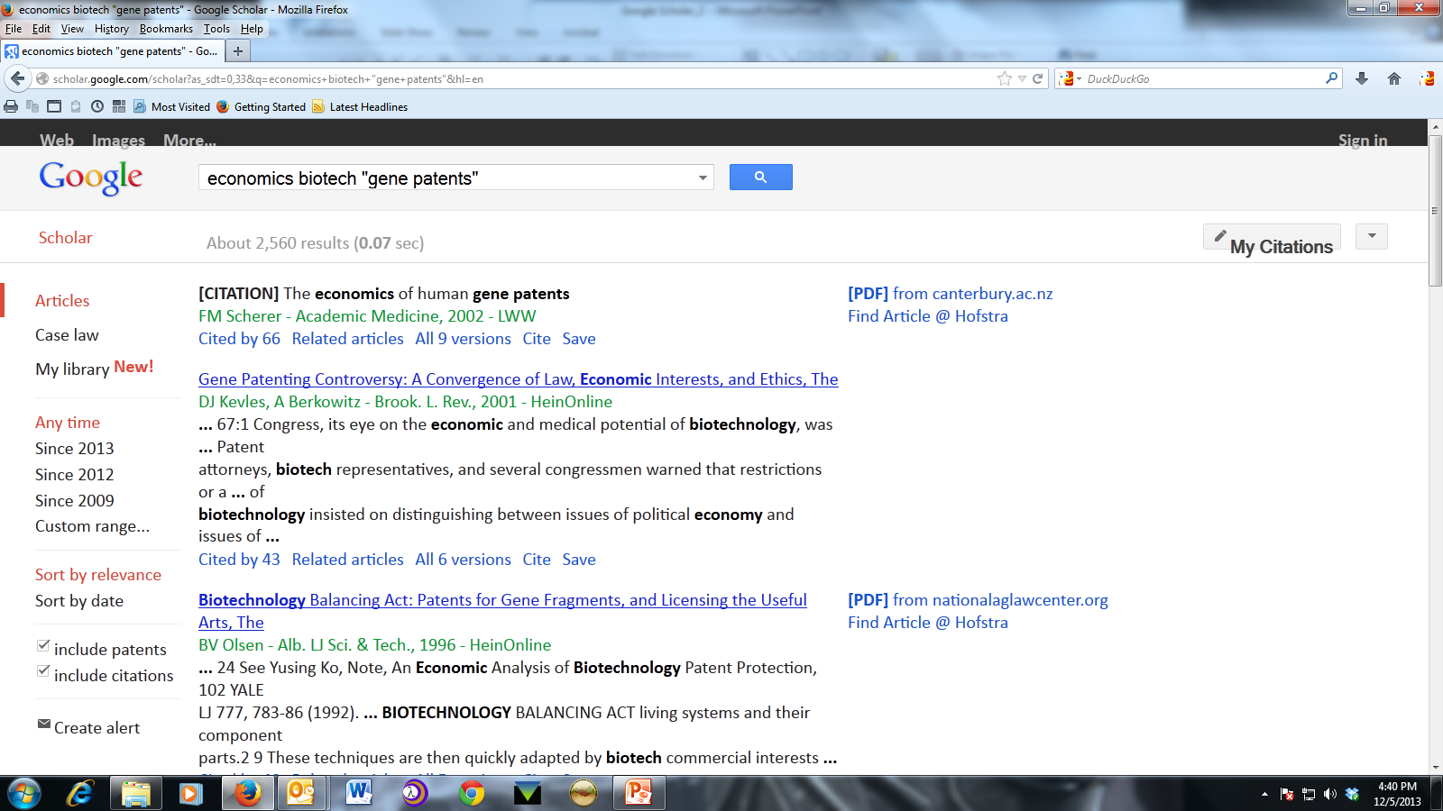
Returned to search results and clicked on Articles link.

Slide 28
Google Scholar
The End
If you would like to know more or have suggestions, please contact: Tricia Kasting, - 100D in Law Library – Patricia.A.Kasting@hofstra.edu

