Slide 1
DEFERRED ACTION FOR CHILDHOOD ARRIVALS (DACA) RENEWAL TRAINING
Prepared by Lauris Wren & Theo Liebmann
Hofstra Law Clinic

Slide 2
DACA – BASIC ELIGIBILITY REQUIREMENTS
Arrived in the US before the age of sixteen;
At least fifteen years old at the time of filing for DACA (some exceptions);
Under the age of thirty-one on June 15, 2012;
Physically present in US on June 15, 2012;
No lawful status on June 15, 2012;
Continuous residence in the US from June 15, 2007 to date of filing;
Currently enrolled in school or GED classes, OR graduated from high school or obtained GED, OR have an honorable discharge from US Coast Guard or Armed Forces; and,
Have not been convicted of a felony offense, a significant misdemeanor offense, three or more misdemeanor offenses, or otherwise pose a threat to national security or public safety.

Slide 3
DACA BENEFITS
Employment authorization document (“EAD” or “work permit”), which enables the recipient to get a social security number, legal employment, a drivers license, etc.
Deferred action (no deportation) for two years and possibly longer.
May be able to get advance parole to travel outside of the US.

Slide 4
DACA LIMITATIONS
DACA does not grant lawful status.
It defers removal as an act of prosecutorial discretion.
On its own, it does not lead to a permanent status.
For the purposes of immigration, a DACA recipient does not accrue unlawful presence, but also is not considered in lawful status.

Slide 5
WHO CAN RENEW DACA?
Prior to Trump’s 9/5/2017 Order Rescinding DACA…
Any DACA recipient who:
Met the guidelines for initial DACA;
Did not depart the US on or after August 15, 2012, without advance parole;
Has continuously resided in the US since applying for DACA;
Has not been convicted of a felony, a significant misdemeanor, or three or more misdemeanors and does not otherwise pose a threat to national security.
Post Trump’s 9/5/2017 Order… Same requirements PLUS…

Slide 6
YOU MUST BE A DACA HOLDER WHOSE WORK PERMIT (EAD) EXPIRES BETWEEN SEPT. 5, 2017, AND MARCH 5, 2018.
AND, FOR THE RENEWAL APPLICATION TO BE CONSIDERED, USCIS MUST RECEIVE IT BY OCT. 5, 2017.
So…
If a person’s DACA has already expired, they cannot renew.
If a person’s DACA does not expire on or before March 5, 2018, they cannot apply to renew.

Slide 8
DOCUMENTATION REQUIRED FOR RENEWAL APPLICATION
Identification documents and copy of EAD (work permit) to renew EAD.
Documentation regarding any NEW issues with arrests, removal proceedings, or travel outside of the US.
Copy of social security card (or just the number).
Two passport-size photos to renew EAD.
Check or money order for $495 made out to U.S. Department of Homeland Security.
Helpful but not necessary to have a copy of prior DACA application.

Slide 9
FORMS REQUIRED FOR RENEWAL APPLICATION
I-821D – the DACA Renewal Form.
I-765 – the EAD Renewal Form.
I-765WS – the EAD Renewal Form Worksheet.

Slide 18
WHAT WILL HAPPEN ON DACA RENEWAL DAY
Locations and Staffing –
Hofstra Law Clinic
9/15 and 9/22 (12-4)
2 two hour shifts, 6 students per shift.
Hofstra Law Clinic
9/29 (12-4)
2 two hour shifts, 10 students per shift.
Nassau Community College
9/25 (10-2)
2 two hour shifts, 10 students per shift.
Salvadoran Consulate
9/30 (9-5)
2 four hour shifts, 10 students shift.
Process –
Reception/Screening
Student Team Completes Applications
Attorney Review
Filing or Not

Slide 19
FILLING OUT THE FORMS
For DACA Holders (DHs) with all required documentation –
DH should read and sign “DACA Renewal Agreement (G-28)”
Fill in information boxes on “DACA Holder Information” sheet
Fill in answers to questions on “Relief Screening Questions” sheet
Complete Forms I-821D, I-765, I-765WS, G-28

Slide 20
FILLING OUT THE FORMS (continued)
For DACA Holders (DHs) without all required documentation –
DH should read and sign “DACA Renewal Agreement”
Fill in information boxes on “DACA Holder Information” sheet
Fill in answers to questions on “Relief Screening Questions” sheet
Complete Forms I-821D, I-765, I-765WS

Slide 21
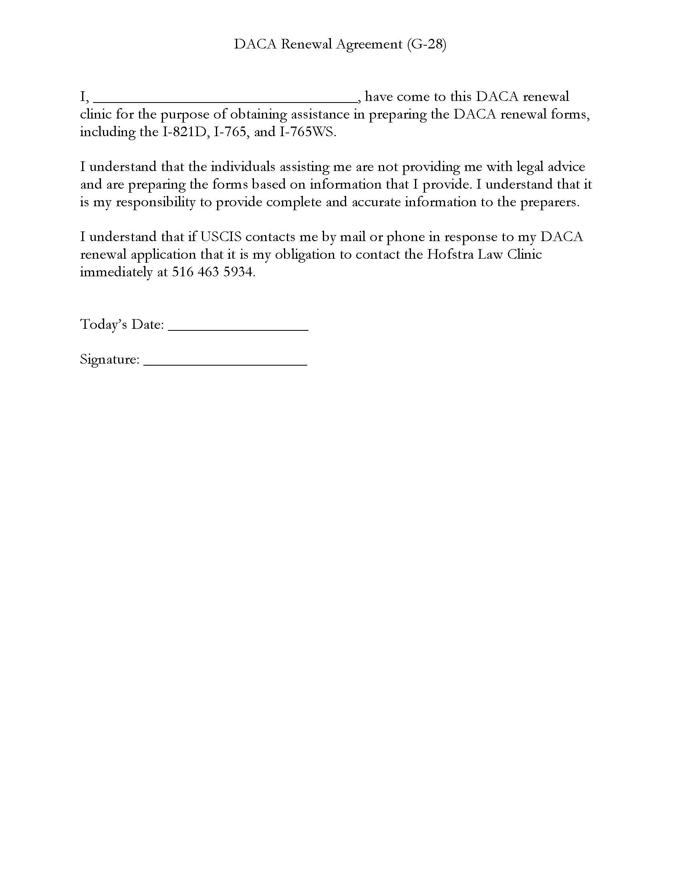

Slide 22
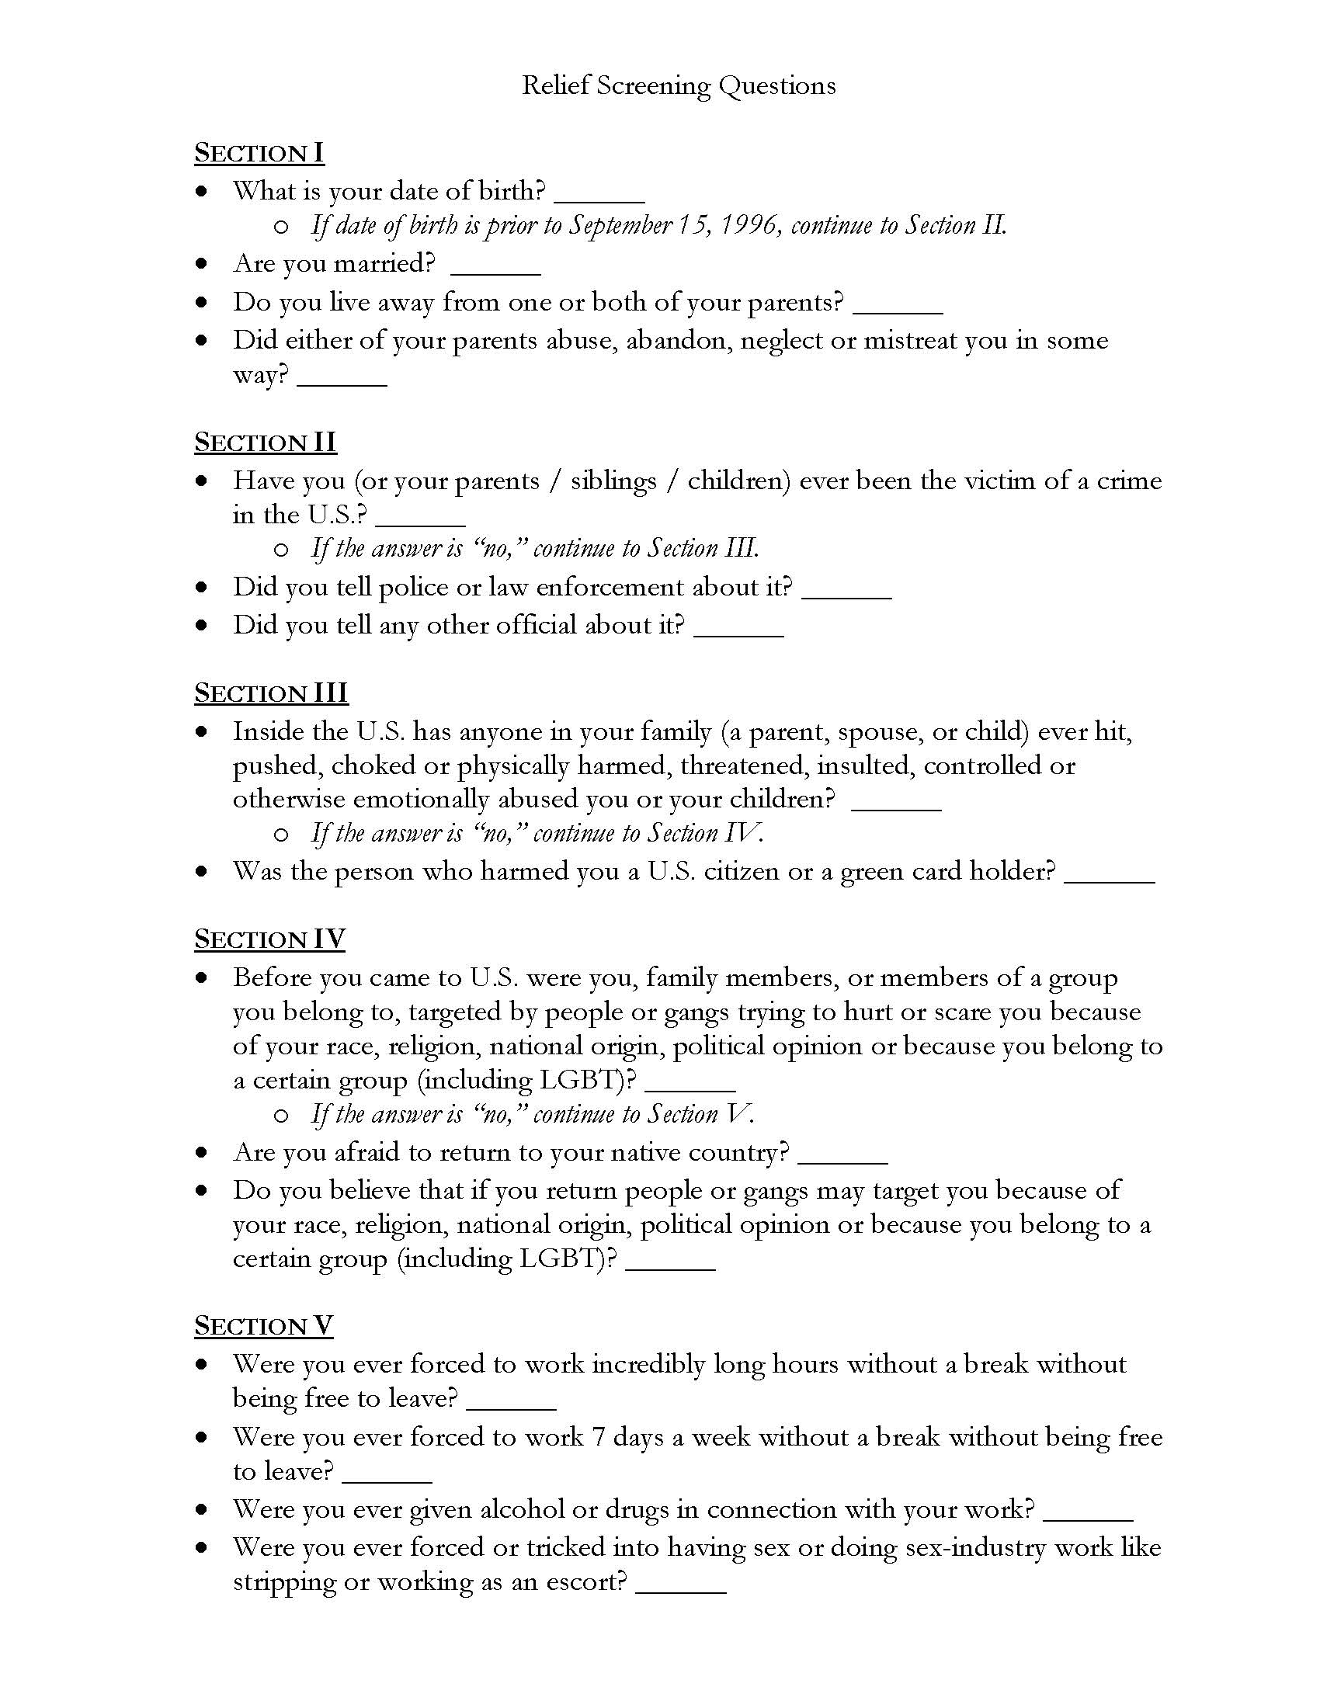

Slide 23
AFTER FILLING OUT APPLICATION
Bring forms and supporting documents to an attorney supervisor for review.
Make two copies of all forms and supporting documents.
Supervising attorney will take form for filing.
Provide one copy to DH.
Supervising attorney will add DH’s name either to list of applications being filed (if DH has all necessary documents) or to list of applicants who will be filing their own applications (if DH does not have all necessary documents).

Slide 24
Next steps:
Sign up for shifts
Additional languages?
Include email
Spread the word!

Slide 25
Explain to DACA Renewal Applicant:
1. Within approximately 2-3 weeks, the applicant should receive a receipt from USCIS. Given the number of applications to USCIS, the receipts may be delayed.
2. Shortly after the receipt, the applicants may receive a notice for a fingerprint appointment. If the applicant receives a receipt but does not receive a fingerprint notice, that is nothing to worry about.
3. If there is anything missing from the DACA renewal application, the applicant may receive a Request For Evidence. If s/he receives that, s/he should contact the Hofstra Law Clinic right away.
4. Approximately 2-3 months after filing, the applicant should receive a letter with the approval or denial of the DACA application and work permit. If approved, the work permit should arrive within a few days of the approval letter.

