Slide 1
Faculty RA Training (Part 2)
Marin Dell, JD MLIS MS/MIS
Reference/Electronic Services Librarian
Hofstra Law Library

Slide 2
Essential Elements of the Research Process ______________________________________________
Frame the question(s) and develop search terms.
Identify, prioritize, and consult relevant sources.
Expand and update your research.
Make sure your research is responsive to the question(s) presented.
Know when to stop.
______________________________________________
“Elements” by Courtney Selby for Research Strategy 101: smart ways to tackle tough questions (Webcasts Spring ‘13) available at: http://law.hofstra.edu/academics/library/research/webcasts/index.html

Slide 3
Faculty RA Training Research Hypothetical 1
Your professor is writing a book on father’s rights and is interested in finding a case from Kentucky where a biological father was unable to bring a court action to have him declared the parent of a child he fathered with a married woman. The biological father had a DNA test that said he was the child’s father, take with the mother’s permission, but was later blocked from presenting it to the family court by the mother and the mother’s husband. The case happened sometime around 2006 – 2008 and has been overturned in the last couple of years.
You are instructed to find the old and new cases for this issue, determine what the new law is (i.e what is the test the court will use to determine whether a case will be brought) and also find some background on the development of the law for fathers in KY.

Slide 4
WestlawNext
http://lawschool.westlaw.com

Slide 5
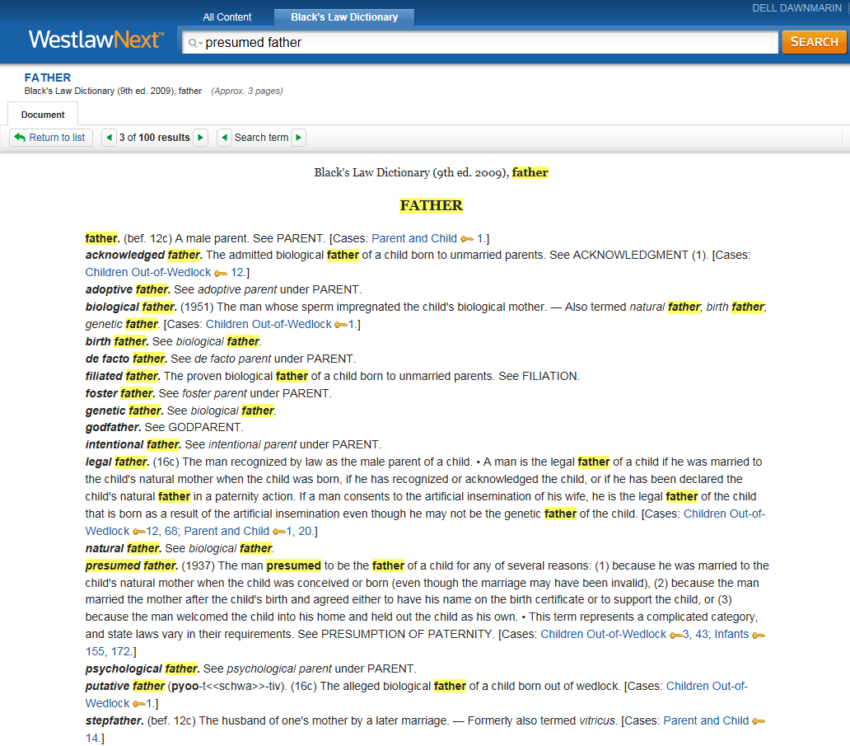

Slide 6
Faculty RA Training Research Hypothetical 2
Your professor has instructed you to research the presumption of legitimacy, the standard for rebutting it, and who can bring the action for every U.S. state. You have Kentucky to use as a model. What do you do next?

Slide 7
Creating a 50 State Survey
Strategy:
Do preliminary research on your topic.
Look for a pre-compiled survey on the topic (even if incomplete).
Determine what to compare and your search terms.
Create your table.
Determine what makes a good search (terms and connectors and good search terms) or use a print index.
Work through your list of results for each state and fill in the table.
Update your work.

Slide 8
50 State Survey LibGuides –
Georgia State University School of Law Library
http://libguides.law.gsu.edu/50statesurveys
University of Texas Law Library
http://tarltonguides.law.utexas.edu/content.php?pid=242166&sid=2028342

Slide 9
Compiled 50 State Surveys
Print –
M.C. Chiorazzi & M. Most (eds.), Prestatehood Legal Materials: A Fifty-State Research Guide, including New York City and the District of Columbia, Hayworth Press: Binghamton, NY (2005).
P.B. Linton, Abortion Under State Constitutions – A State by State Analysis (2d ed.), Carolina Academic Press: Durham, N.C (2012).

Slide 10
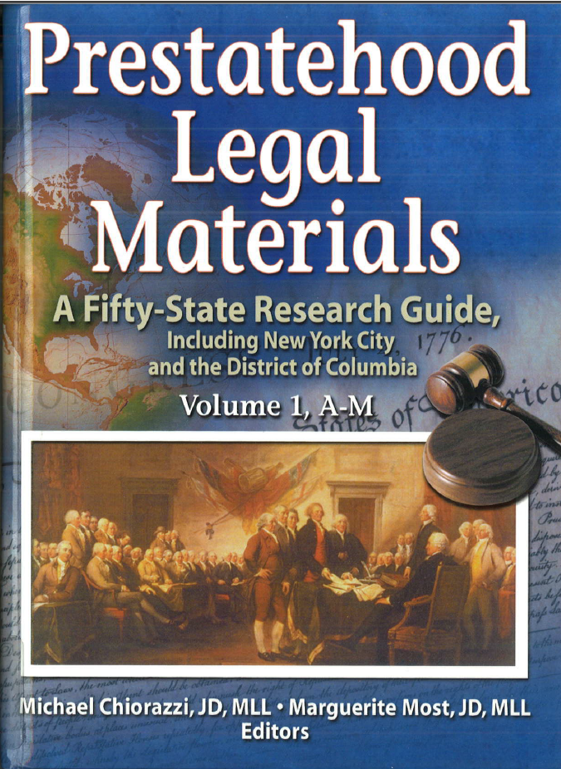

Slide 11
Print/electronic versions –
R.A. Leiter (ed.), National Survey of State Laws (6th ed.), The Gale Group: Farmington Hills, MI (2008). & WestlawNext -> Secondary Sources ->50 State Surveys -> 50 State Statutory Surveys
C.R. Nyberg, Subject Compilations of State Laws, Carol Boast and Cheryl Nyberg: Twin Falls, ID (2008). Note: print ends in 2008 & Heinonline -> Subject Compilations of State Laws -> Database
ALR and ALR Fed (print ) & WestlawNext and Lexis Advance

Slide 12
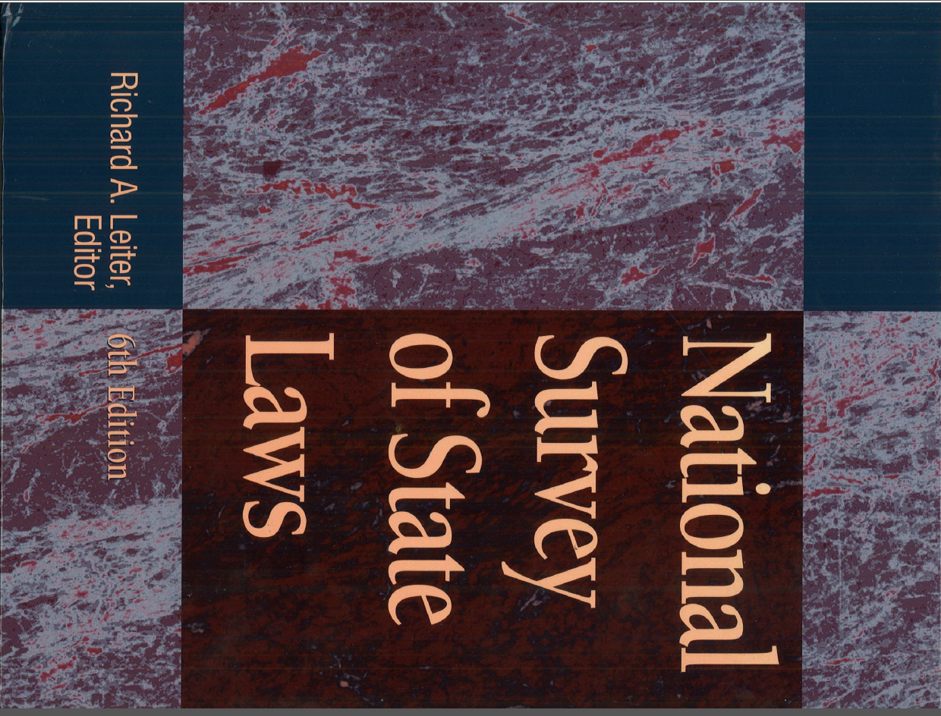

Slide 13
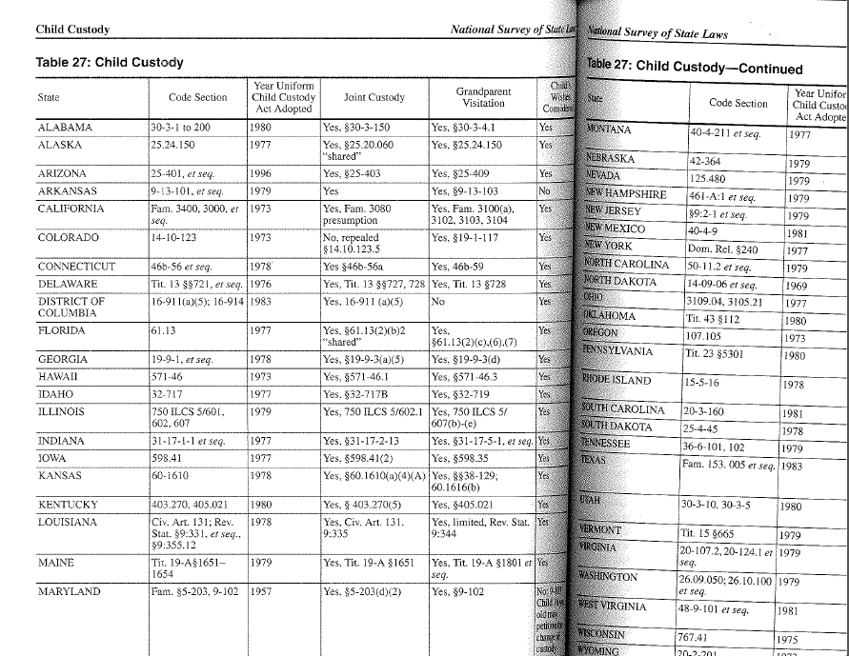

Slide 14
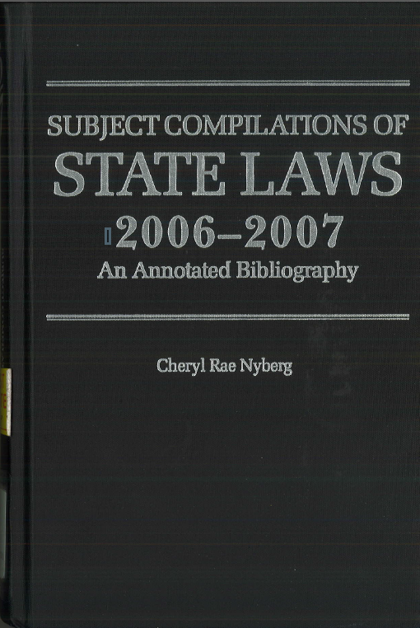

Slide 15
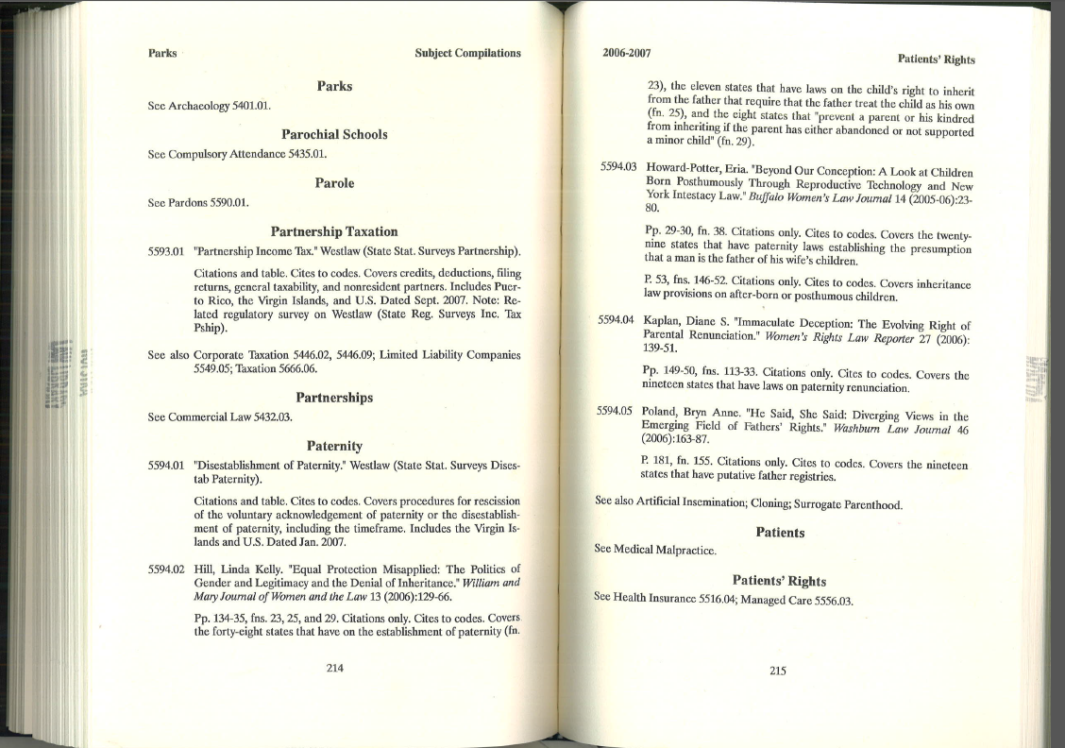

Slide 16
Electronic –
WestlawNext –-> Secondary Sources ->50 State Surveys -> 50 State Statutory Surveys; 50 State Regulatory Surveys http://lawschool.westlaw.com
Lexis.com -> 50 State Surveys http://lexisnexis.com/lawschool
BNA – (many of the online reporters have state compilations)
ABA/BNA Lawyers’ Manual on Professional Conduct -> Ethics Opinions -> State Ethics Opinions http://0-lawyersmanual.bna.com.libweb.hofstra.edu/mopw2/
Tax and Accounting Center -> State (tab) -> Tables, Charts and Lists (state) http://0-taxandaccounting.bna.com.libweb.hofstra.edu/btac/
Internet –
National Conference of State Legislatures (http://www.ncsl.org)

Slide 17
More questions?
See a reference librarian!

