Slide 1
International Environmental law research
Shikha Gupta Joseph: shikha.joseph@hofstra.edu
Spring 2014

Slide 2
Agenda
Basic Definitions
Research Process
Sources for Research

Slide 3
Basic Definitions
International Law
Public
Private
Foreign Law
Comparative Law

Slide 4
Research Process/Strategy
Identify question
Identify sources of the law for your question
Locate those sources
Search
Review results
Search again
Repeat
OR
Secondary Sources-look at treatises, legal encyclopedias, and law review articles to learn about the topic.
create a list of search/key terms
Primary Sources-look for treaties or conventions which may be applicable.
search for statutes, laws, regulations
research case law
Update your research, check pocket parts/supplements.

Slide 5
Sources of International Law
International Conventions/Treaties
International Custom
General Principles of Law
Judicial Decisions

Slide 6
Books: Getting Started and Background Information
Library catalog (LEXICAT) (a good book can provide background; citations to cases, articles, statutes, Congressional reports, internet sites)
Search: keyword: “marine resources”
Subject headings: Marine resources conservation -- Law and legislation.
Search: keyword: fisheries pollution
Select: #43, The world ocean in globalisation [electronic resource] : climate change, sustainable fisheries, biodiversity, shipping, regional issues / edited by Davor Vidas, Peter Johan Schei. (2011)
Check contents and other subject headings: Shellfish fisheries -- Sanitation – Congresses.
Electronic book tips: on Electronic Books (Ebrary): Must have downloaded Ebrary Reader software; printing-under Tools; print limited number of pages.

Slide 7
Treatises: Getting Started and Background Information
Guide to International Environmental Law/by Alexandre Kiss; Dinah Shelton, Law Classified, K3585.4.K5695 2007; E-book link
International Environmental law in a Nutshell/by Lakshman D. Guruswamy; Mariah Zebrowski Leac, Law Reserve K3585.6 .G87 2012
International Law & the Environment/by Patricia Birnie, Alan Boyle, Catherine Redgwell, Law Classified, K3585.4 .B57 2009
To find a treatise online: WestlawNext: click on “Secondary Sources” then under By Type, choose Texts & Treatises, then By Topic, select Energy & Environment. Lexis Advance: click on Browse Topics, select Environmental Law or Energy & Utilities Law, click on a sub-topic, choose the Second tab, and on right side column select Treatises.
When to ask a librarian: Your book is out and not due for months. You cannot find your treatise or publication online. You have searched several databases, Westlaw, and Lexis and still can’t find an article on point. You have found a good citation, but can’t find a print or digital copy or a database is not accessible. You have found a citation to a book (in another book, WorldCat, Amazon, an article) and Hofstra doesn’t have it.

Slide 8
Current Issues
BNA Environment Reporter (available through the Law Library website)
BNA International Environment Reporter (available through the Law Library website)
Environment & Energy Daily (available through the Law Library website)
Environmental Law Reporter News & Analysis (available on Lexis Advance and WestlawNext)

Slide 9
Article Finding
Index to Legal Periodicals (available through the Law Library website)
Index to Foreign Legal Periodicals (available through the Law Library website)
HeinOnline (available through the Law Library website)
WestlawNext
Lexis Advance
SSRN (Social Science Research Network)-for scholarly working papers, forthcoming law review articles, think tank articles (new and very recent research) (tip: use the Keywords section to find additional terms for the search.)
Axinn Subject Databases-for interdisciplinary scholarly articles. Example: Business Source Premier, Academic Search Premier etc. (tip: use the Subject: Thesaurus Term or Subject features to find additional terms and articles for the search.)

Slide 10
Basics of Treaty Research
What are the applicable treaties?
Who are the parties?
What are the relevant national laws of the parties?
US Law
Foreign Law
Proper citation to treaty (check Bluebook for correct citation format)

Slide 11
Treaties and Conventions
Print Collections
International Environmental Soft Law: Collection of Relevant Instruments / by W.E. Burhenne; Marlene Jahnke, Law Classified K3583 .I58
International Protection of the Environment: Conservation in Sustainable Development / by Wolfgang E. Burhenne & Nicholas A. Robinson, eds., Law Classified K3585.4 .I5478
Environmental law treaties of the United States / by Nicholas A. Robinson, Law Classified K3583.2 .U6 1997

Slide 12
Treaties and Conventions-cont.
Online Sources
ECOLEX: http://www.ecolex.org/start.php
EISIL:http://www.eisil.org/index.php?sid=850442477&cat=18&t=sub_pages
Environmental Law Instruments(UNEP): http://www.unep.org/Documents.Multilingual/Default.asp?DocumentID=52&ArticleID=89
Environmental Treaties and Resource Indicators (ENTRI): http://sedac.ciesin.org/entri/
United Nations Treaty Collection: http://treaties.un.org/Pages/UNTSOnline.aspx?id=1
Treaties in Force: http://www.state.gov/s/l/treaty/tif/index.htm
United States Senate-Treaties: http://www.senate.gov/pagelayout/legislative/d_three_sections_with_teasers/treaties.htm
Thomas: http://thomas.loc.gov/home/treaties/treaties.html

Slide 13
Treaties and Conventions-cont.
Database Sources
HeinOnline: Treaties and Agreements Library
WestlawNext
Lexis Advance
Status and Ratification Information
United Nations Treaty Collection

Slide 14
Case Law
International Court of Justice
International Environmental Law Reports: Law Classified, K3581.2 .R63
Environmental Law Reporter News & Analysis: (Limited access at http://elr.info, full access available on Lexis Advance and WestlawNext)
WestlawNext
Lexis Advance
Bloomberg Law

Slide 15
Foreign Law
Cornell Law School Legal Information Institute – Global (available through the Law Library website)
World Legal Information Institute (available through the Law Library website)

Slide 16
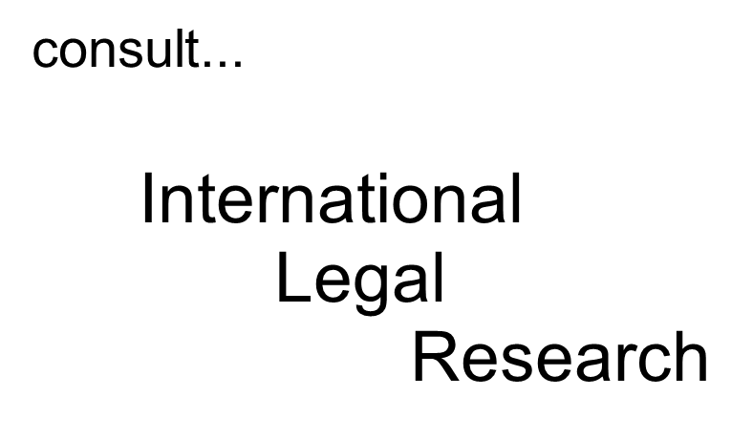
Final Tip

