Slide 1
Cost effective research for New York: finding what you need without breaking the bank
by Shikha Joseph and Toni Aiello

Slide 2
Today we will cover:
Free New York resources (i.e. cases, statutes, legislation and regulations)
Strategies for cost-savings by using other subscription databases and resources
Cost effective use of Westlaw & Lexis for New York research

Slide 3
Free resources (i.e. cases, statutes, legislation & regulations)
Cornell LII(http://www.law.cornell.edu/) (cases, statutes, legislation, regulations, etc.)
Findlaw (http://www.findlaw.com/casecode/new-york.html) (cases, statutes, legislation, etc.)
Google Scholar (http://scholar.google.com/) (cases)
New York State Legislature (http://public.leginfo.state.ny.us/menuf.cgi) (statutes)
New York Unified Court website (http://www.courts.state.ny.us/index.htm ) (cases, statutes, legislation, etc.)
New York State Department of State (http://www.dos.ny.gov/info/nycrr.html) (regulations, rules, codes, New York State Register, etc.)

Slide 4
Strategies for cost-savings by using other subscription databases and resources
Look for industry specific databases, such as:
HeinOnline-law reviews and journals, international materials, government documents such as the Federal Register and CFR
BNA-various areas of law
CCH Intelliconnect-commercial and corporate law
RIA Checkpoint-tax and estate planning
Use a combination of the books and online resources
Government websites-agencies, city and state sites
Google (BE AWARE of reliability, bias and currency of information)

Slide 5
Cost effective Lexis & Westlaw
Lexis Advance
http://www.lexisnexis.com/lawschool/login.aspx
WestlawNext
https://lawschool.westlaw.com/

Slide 6
Cost effective Lexis & Westlaw
What’s Happening Now?
Fast migration in all practice settings to new versions
New attorneys leading transition in workplaces
Pricing plans for both systems changed with introduction of WestlawNext and Lexis Advance
Cost effective online research strategies are evolving
cost effective research essential in tough market

Slide 7
Cost effective Lexis & Westlaw
What you MUST KNOW at your workplace:
Which services (Lexis/Westlaw/both) are available to you in your position
What is in your WestlawNext or Lexis Advance subscription package and what pricing plan is used
What training is available: from vendor representative, librarian, online
Your institution’s approach to managing online research costs
How to search effectively on both systems
Key New York resources in your package—for both WestlawNext and Lexis Advance
What alternative online subscriptions are less expensive to use, for the same source
What print (and free online) resources are available in-house; in nearby court and law school libraries (Hofstra law always available to alumni)

Slide 8
Cost effective Lexis & Westlaw
What you MUST DO at your workplace:
Make full use of law office librarians
Learn all you can from assigning attorney before starting your research
Have a research plan before you go online
Know and use the special features on each system that improve efficiency

Slide 9
Cost effective Lexis Advance
Today’s Lexis Advance Subscriptions
Most law practices have a flat-rate subscription pricing plan for specified content, selected for its primary practice areas
With all plans, it costs to view content that is “out of plan”
With all plans, many functions previously charged for under hourly or transactional plans are now FREE:
Searching across all Lexis Advance content, including News
Pre- and post-search filtering
All document delivery, including printing
Shepardizing—not charged until you link to an out of plan document
Using Table of Contents and special features like “Topic Summaries”
Saving to work folders; updating any Shepard’s report in a folder for 1 year
Accessing all documents in your History—for 90 days

Slide 10
Cost effective Lexis Advance
“Out of Plan” Notification
A Lexis Advance standard feature
You are notified before you link to a listed document that it is outside your plan
“Free preview” option—you may elect to see a brief summary and the price to access it
Lexis Advance Price Guide (under the “Help” tab)

Slide 11
Cost effective Lexis Advance

Slide 12
Cost effective Lexis Advance
Some Key “Lexis Only” Sources for New York
Weinstein, Korn and Miller, New York Civil Practice: CPLR
Bender’s Forms for the Civil Practice
LexisNexis New York Answer Guides
Example: LexisNexis AnswerGuide New York Criminal Procedure
New York Law Journal (two different sources: one for articles, one for cases in the NYLJ since 1989)
Example: New York Law Journal (locate articles)
In Browse Sources, at New York Law Journal, select: “Add this source to the search” Search: no fault divorce; filter by Timeline (s012-2013)
Wall Street Journal (full-text, online and print versions)

Slide 13
Cost effective Lexis Advance
Cost efficient feature: Topic Summaries
A topic summary, accessed from a case your are viewing, gives you an overview of the topic, including definitions, elements, seminal cases and secondary source links. Select your jurisdiction.
Link to a topic summary from:
1. “About this Document” box, right frame
2. Brown “briefcase” icon in relevant headnote (must “Show Headnotes”)
Example: Start at: Thing v. La Chusa, 48 Cal. 3d 644 (damages to bystander, emotional distress). Link to Topic Summary; Other jurisdictions: New York

Slide 14
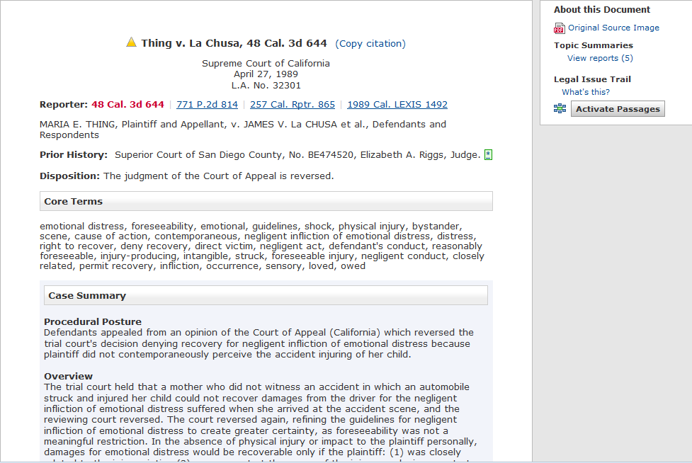
Cost effective Lexis Advance

Slide 15
Cost effective Lexis Advance

Slide 16
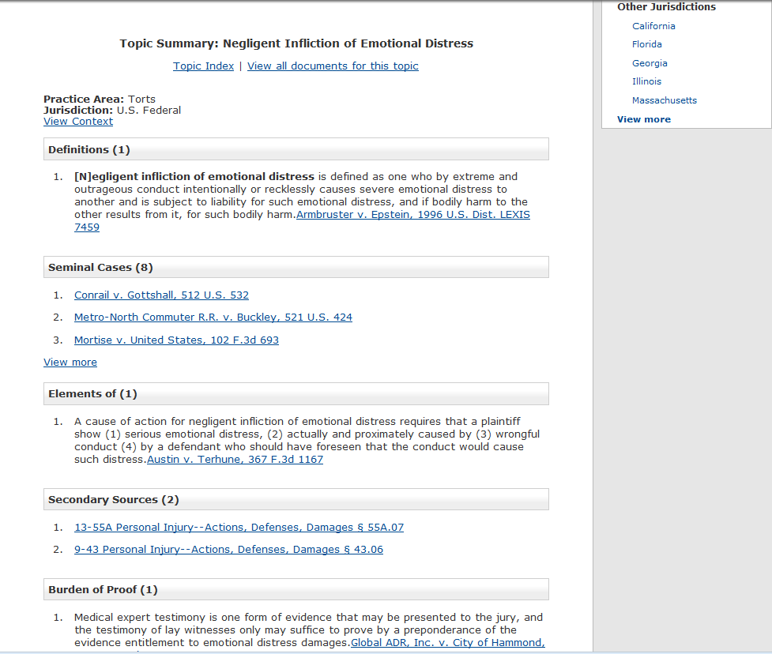
Cost effective Lexis Advance

Slide 17
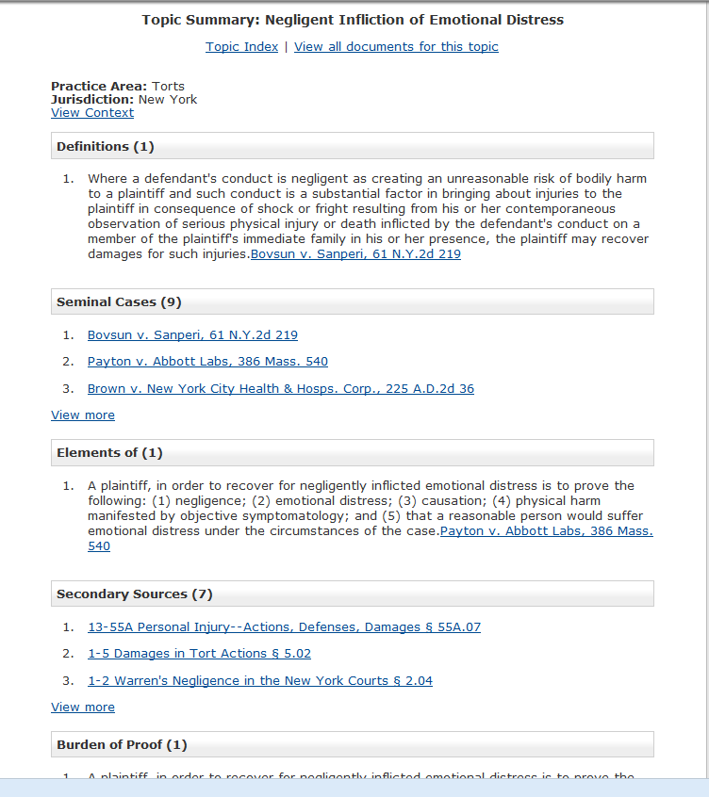
Cost effective Lexis Advance

Slide 18
Cost effective Lexis Advance
Learning Resources for Cost Effective Research:
Vendor-provided training sessions at Law Library
(current students: register for training sessions at Lexis home page)
Lexis representative sessions at workplace
Training offered by workplace librarian
Videos available on YouTube (student ID password to access quizzes):
Researching cost effectively with Lexis Advance
http://www.youtube.com/watch?v=x5zfQF1mpl
Law Firm Simulation: Understanding Research Charges on Lexis Advance
(Walks you though an assignment at a small firm, including details on their Lexis Advance subscription, cost effective research skills and calculating client charges)
http://www.youtube.com/watch?v=xmBWUwz8BWg

Slide 19
Cost effective WestlawNext
Today’s WestlawNext Subscriptions
Pricing plan concept differs significantly from Lexis Advance
They are a combination of:
1. a content package—sources available to employees for which a monthly “flat fee” is charged for access
AND
2. any number of “chargeable events”, such as searching, viewing a document, KeyCite, document delivery, or filtering, in addition to “out of plan” access charges.
What actions or features are “chargeable events” differs widely by plan.
Some employers request that an “out of plan” notification be activated when an attorney tries to access “out of plan” sources—others do not.

Slide 20
Cost effective WestlawNext
7 things that are ALWAYS FREE on WestlawNext:
Creating folders (unlimited)
Saving documents to folders
Taking notes or highlighting a document
Using the “copy with reference” feature
Reading a scope note (i link)—description and date coverage of a source
Viewing any document in your HISTORY—only until 2 am of the following day
Automatic updates of KeyCite reports saved to your folders (whenever opened)
For everything else, IT DEPENDS!
**Must be familiar with employer’s subscription plan.

Slide 21
Cost effective WestlawNext
Some Key “Westlaw Only” Sources for New York:
McKinney’s Consolidated Laws of New York Annotated
Siegel’s New York Practice (key treatise, NY civil practice)
New York Practice Series (treatises, specific practice areas)
Example: Secondary Sources—New York—Texts and Treatises—New York Practice Series)
**Most firms select content packages tailored to include the key resources for their primary practice areas.

Slide 22
Cost effective WestlawNext
Cost efficient feature: West Key Number System
To find relevant case law on an issue
Online version of a comprehensive digest, state and federal
Find under: Tools
New York research example:
Can a bystander be awarded damages for negligent infliction of emotional distress under New York law?
Jurisdiction: New York and Related Federal
Select: Negligence; Damages
Search: emotional distress
Click on: 115 (Damages) 57.16 Nature of Injury or Threat
Click on: –(2) Physical injury , illness or impact, zone of danger
Search within results: bystander

Slide 23
Cost effective WestlawNext
Learning Resources for Cost Effective Research:
Vendor-provided training sessions at Law Library—current students
(register on Westlaw Training page, after sign-in)
Lexis representative sessions at workplace
Training offered by workplace librarian
Special tutorials on Westlaw Training page:
Westlaw 301 (Certification Training)
Student Webinars: Certification 301
(register online for March 8, 2013 at 1:00 p.m.)

Slide 24
Cost Effective Research for New York
Questions?

